Slide 1
Monday

Slide 2
Course Logistics
Problem Set 2 – Due Wednesday, Feb. 22
PS1 grading is ongoing…
Project Milestone 2 – Due Friday, Feb. 17
Groups are set up, Milestone 1 Feedback is in canvas (but not yet posted due to a bug, working on it)
I invite further conversations about your projects in OH, before / after class, etc. I went through them all, but they are a bit of a blur so you’ll have to remind me what you’re doing.

Slide 3

Evaluating Models
Back to it!

Slide 4
Types of Errors (Week 2)
Classified As Ground Truth | C | ~C
C | True Positive (Hit) | False Negative (Miss)
~C | False Positive (False Alarm) | True Negative (Correct Rejection)

Slide 5
Types of Errors
Predicted Positive Rate (Precision) = Hits / (Hits + False Alarm)
Classified As Ground Truth | C | ~C
C | True Positive (Hit) | False Negative (Miss)
~C | False Positive (False Alarm) | True Negative (Correct Rejection)

Slide 6
Types of Errors
True Positive Rate (Sensitivity, Recall) = Hits / (Hits + Miss)
Classified As Ground Truth | C | ~C
C | True Positive (Hit) | False Negative (Miss)
~C | False Positive (False Alarm) | True Negative (Correct Rejection)

Slide 7
Types of Errors
1 - False Positive Rate (Specificity) = Corr. Rej. / (False Alarm + Corr. Rej.)
Classified As Ground Truth | C | ~C
C | True Positive (Hit) | False Negative (Miss)
~C | False Positive (False Alarm) | True Negative (Correct Rejection)

Slide 8
Confusion Matrix
Classified As Ground Truth | C | ~C
C | Count of True Positives (Hit) | Count of False Negatives (Miss)
~C | Count of False Positives (False Alarm) | Count of True Negatives (Correct Rej.)

Slide 9
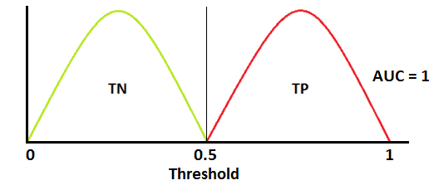
Classification Errors
Notes:
https://towardsdatascience.com/understanding-auc-roc-curve-68b2303cc9c5

Slide 10
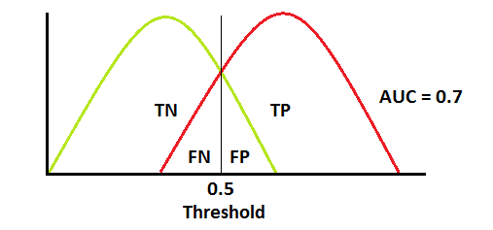
Classification Errors
Notes:
https://towardsdatascience.com/understanding-auc-roc-curve-68b2303cc9c5

Slide 11
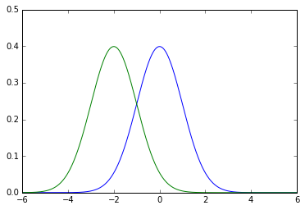
Gaussian Distributions

Slide 12
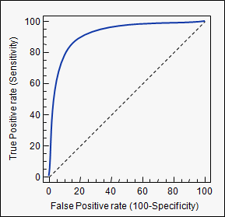
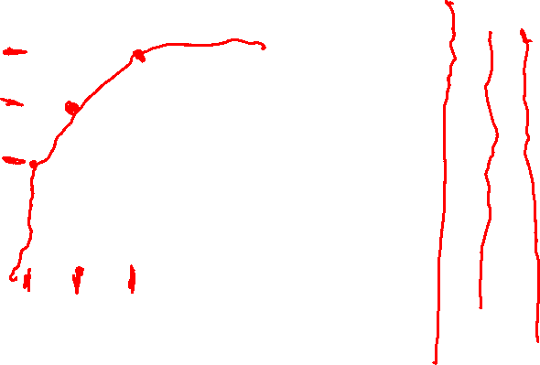
Classification Errors
Notes:
https://www.medcalc.org/manual/roc-curves.php

Slide 13
Classification Errors – ROC Curve (receiver operating characteristic)
Notes:
https://www.medcalc.org/manual/roc-curves.php

Slide 14
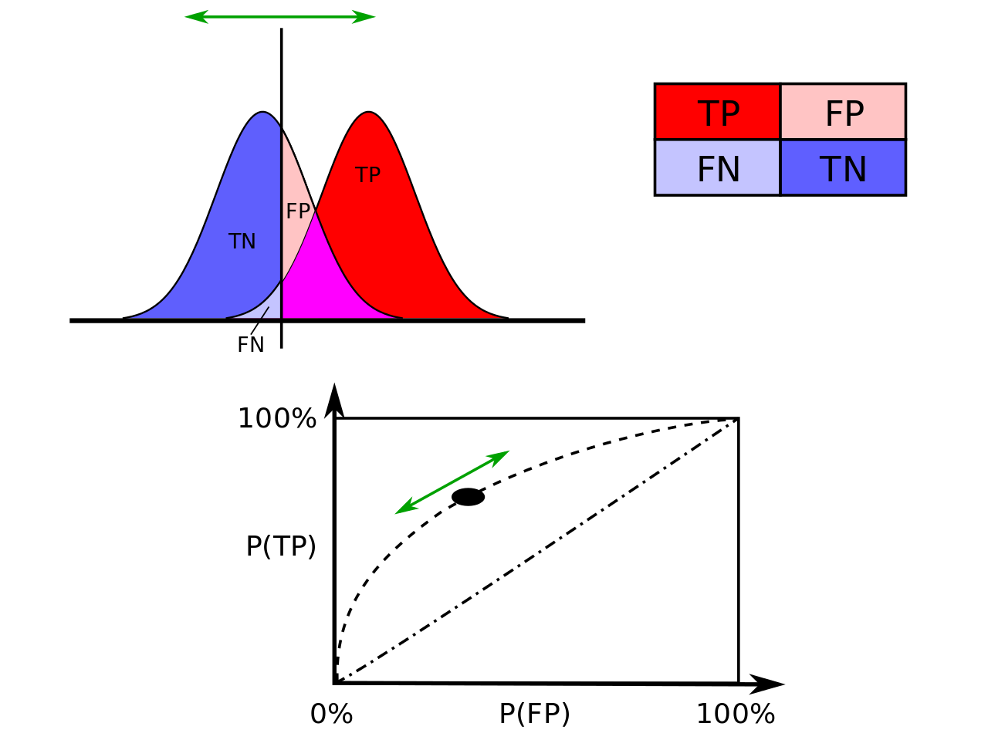
Adapting True Pos rate vs. False Pos rate (sensitivity vs. specificity)
Notes:
https://en.wikipedia.org/wiki/Receiver_operating_characteristic#/media/File:ROC_curves.svg

Slide 15

ROC Curve vs AUC
Notes:
https://www.medcalc.org/manual/roc-curves.php

Slide 16
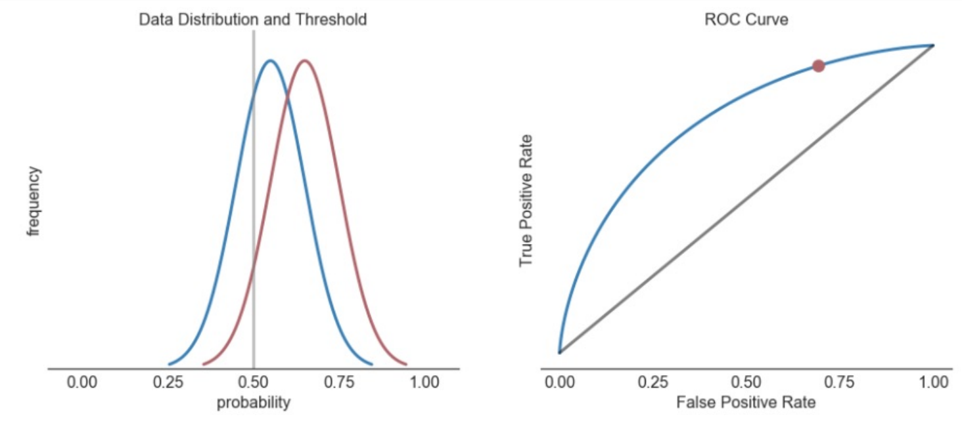


Sharpness of ROC Curve

Slide 17
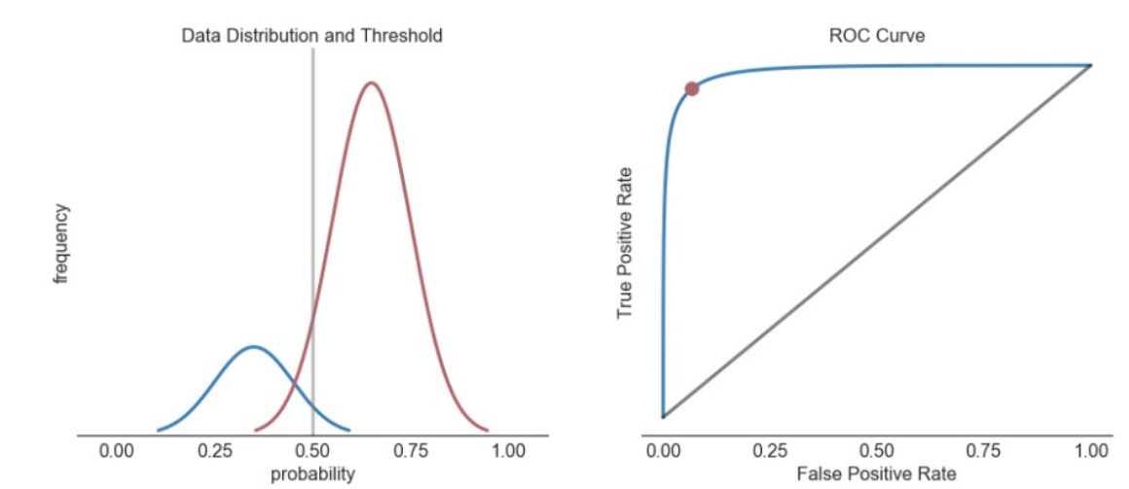
Non-Identical Distributions - Skew

Slide 18
Non-Identical Distributions - Skew

Slide 19
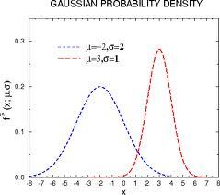

Non-Identical Distributions – different dev.
Notes:
https://prateekvjoshi.files.wordpress.com/2012/09/wide-vs-narrow.jpeg?w=584

Slide 20
Goodness of Fit

Slide 21
Bias vs. Variance
Bias – The inability of the model to represent the underlying training data
Variance – The sensitivity of the model to the training data

Slide 22
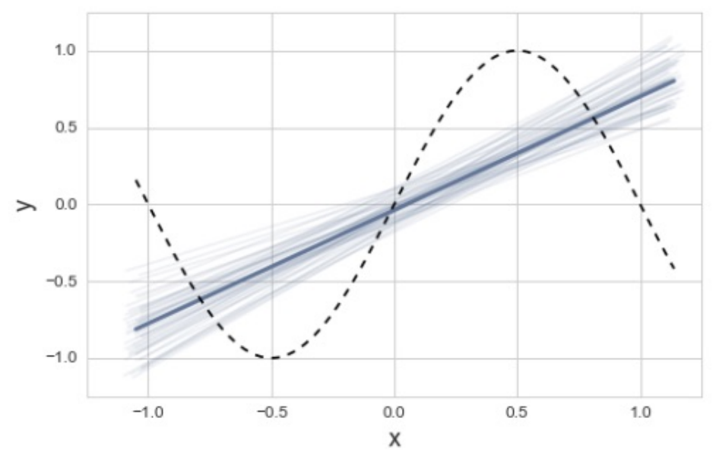
Bias – Variance Tradeoff

Slide 23
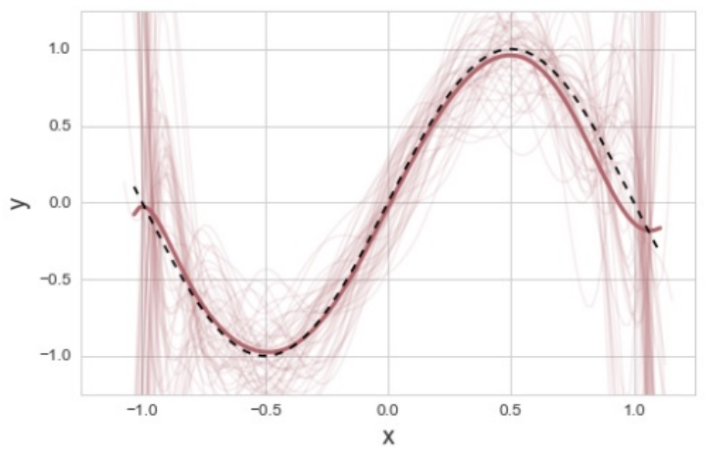
Bias – Variance Tradeoff

Slide 24
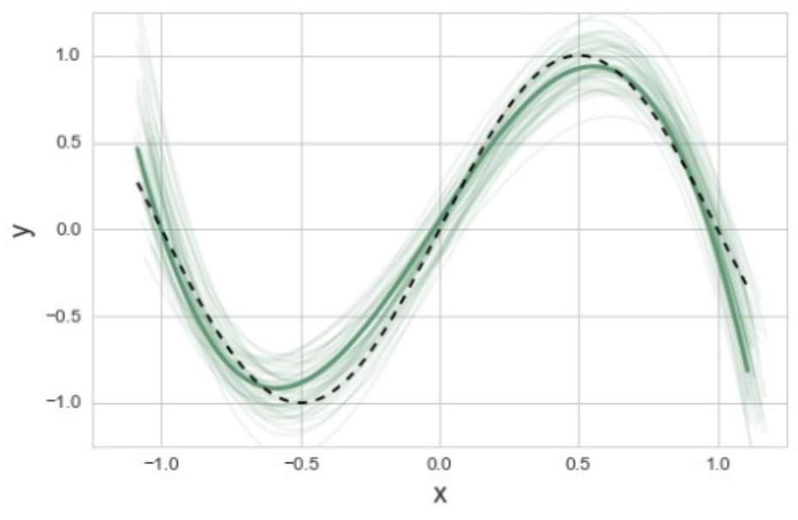
Bias – Variance Tradeoff

Slide 25
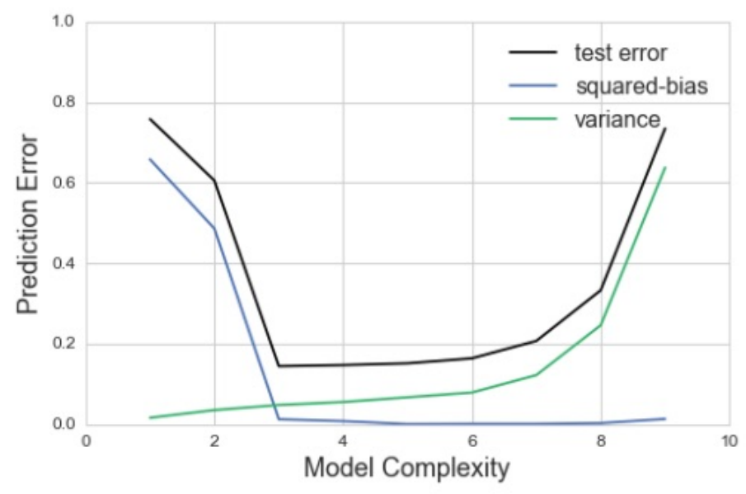

Bias – Variance Tradeoff
Error = ||Y – Ŷ||² can be decomposed into Bias, Variance, and irreducible error

Slide 26
Reporting Model Goodness
Various approaches explored in this class
- Accuracy (correct vs. incorrect classification)
- F1 Score (balance of Precision & Recall
- ROC Curve (false positives & false negatives)
Are these relevant to a regression problem?
What have we been using so far to measure goodness?

Slide 27
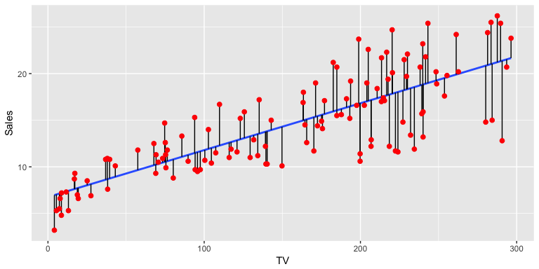
Residual Sum of Squares
RSS(w) = ||Y – Xw||² = ∑_{i=1→m} (y_{i} – w ∙ x_{i})²
We’re looking for the least-squares solution
Notes:
https://uc-r.github.io/public/images/analytics/regression/sq.errors-1.png

Slide 28
Reporting goodness using RSS
RSS is a general notion of goodness of fit
Transformations of RSS get us to a notion like accuracy
- “I have 95% confidence that I am within $5,000 of offer price”

Slide 29
Reporting goodness using RSS
RSS is a general notion of goodness of fit
Transformations of RSS get us to a notion like accuracy
- “I have 95% confidence that I am within $5,000 of offer price”
- “I have 95% confidence that I am within 5,000 miles of home”
We shouldn’t need to interpret appropriate goodness for each problem

Slide 30
Developing goodness – a baseline
Yuma weather: sunny = True - 84 % Accuracy
- Using no features, I simply predict the majority label
Can we do a similar thing with a regression problem?

Slide 31
Developing goodness – a baseline
Yuma weather: sunny = True - 84 % Accuracy
- Using no features, I simply predict the majority label
Can we do a similar thing with a regression problem?
House Cost = $1
House Cost = $1,000,000

Slide 32
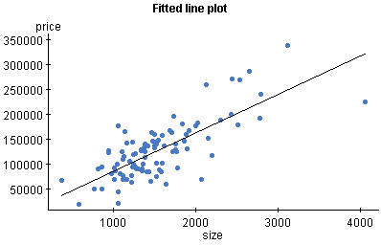
Developing Goodness – a baseline

Slide 33
Developing goodness – a baseline
Yuma weather: sunny = True - 84 % Accuracy
- Using no features, I simply predict the majority label
Can we do a similar thing with a regression problem?
House Cost = <the average cost of a house>

Slide 34
Developing Goodness – a baseline

Slide 35
Developing goodness – alternative view
Yuma weather: sunny = True - 84 % Accuracy
- “There is no variance, assume the average state”
Can we do a similar thing with a regression problem?
House Cost = “There is no variance, assume the average state”

Slide 36
Developing goodness – a baseline
Baseline (Total Sum of Squares) = ||Y–avg(Y)||²
Our Error (Residual Sum of Squares) = ||Y–Xw||²
Improvement: ||Y–Xw||² vs ||Y–avg(Y)||²

Slide 37
Developing goodness – coefficient of determination R²
Baseline (Total Sum of Squares) = ||Y–avg(Y)||²
Our Error (Residual Sum of Squares) = ||Y–Xw||²
Improvement: ||Y–Xw||² vs ||Y–avg(Y)||²
R² = 1 – RSS/TSS

Slide 38
Perceptrons
(A secret start to Deep Learning!)

Slide 39
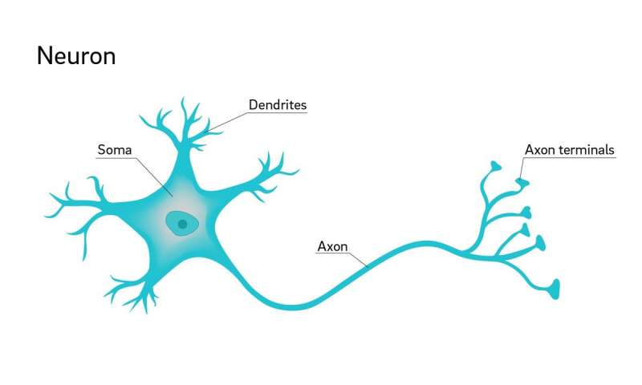

Interlude – the Neuron
Dendrites receive
electrical input from
other cells
Soma combines input,
produces output on axon
Axon connects to other
Neurons (@ dendrites)

Slide 40
Perceptrons – A Basic Approach
Decision Function
Data
Answer

Slide 41
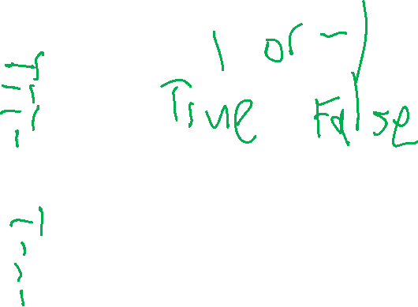
Binary Perceptrons – Decision Functions
Binary AND
Binary OR
1 | X₁ | X₂ | Output
1 | 0 | 0
1 | 0 | 1
1 | 1 | 0
1 | 1 | 1
1 | X₁ | X₂ | Output
1 | 0 | 0
1 | 0 | 1
1 | 1 | 0
1 | 1 | 1

Slide 42
Binary Perceptrons – Decision Functions
Binary AND
Binary OR
1 | X₁ | X₂ | Output
1 | 0 | 0 | -1
1 | 0 | 1 | -1
1 | 1 | 0 | -1
1 | 1 | 1 | 1
1 | X₁ | X₂ | Output
1 | 0 | 0 | -1
1 | 0 | 1 | 1
1 | 1 | 0 | 1
1 | 1 | 1 | 1

Slide 43
Perceptrons = Classifiers
X₀
W₀
Y₁
X₁
W₁
1 or -1
W₂
X₂

Slide 44
Binary Perceptrons – Decision Functions
Binary AND WEIGHTS DECISION FUNCTION
1 | X₁ | X₂ | Output
1 | 0 | 0 | -1
1 | 0 | 1 | -1
1 | 1 | 0 | -1
1 | 1 | 1 | 1
Y₁
X₁
W₁
1 or -1
W₂
X₂

Slide 45
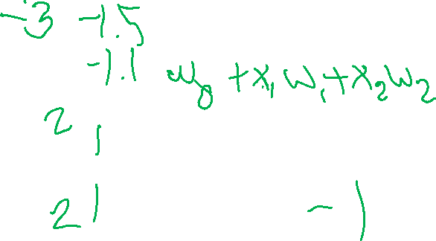
Binary Perceptrons – Decision Functions
Binary AND WEIGHTS
1
W₀
1 | X₁ | X₂ | Output
1 | 0 | 0 | -1
1 | 0 | 1 | -1
1 | 1 | 0 | -1
1 | 1 | 1 | 1
Y₁
+/-
X₁
W₁
1 or -1
W₂
X₂

Slide 46
Binary Perceptrons – Decision Functions
Binary OR
1
W₀
1 | X₁ | X₂ | Output
1 | 0 | 0 | -1
1 | 0 | 1 | 1
1 | 1 | 0 | 1
1 | 1 | 1 | 1
Y₁
X₁
W₁
1 or -1
W₂
X₂

Slide 47
Binary Perceptrons – Decision Functions
Binary NAND
1
W₀
1 | X₁ | X₂ | Output
1 | 0 | 0 | 1
1 | 0 | 1 | 1
1 | 1 | 0 | 1
1 | 1 | 1 | -1
Y₁
X₁
W₁
1 or -1
W₂
X₂

Slide 48
Binary Perceptrons – Decision Functions
A more Complex Problem…
Student | X₁ | X₂ | Y
A | 1200 | 26 | 1
B | 1450 | 28 | 1
C | 1000 | 20 | 1
D | 730 | 15 | -1
NEW | 720 | 16 | ???

Slide 49
Binary Perceptrons – Decision Functions
College Admission
1
Student | X₁ | X₂ | Y
A | 1200 | 26 | 1
B | 1450 | 28 | 1
C | 1000 | 20 | 1
D | 730 | 15 | -1
NEW | 720 | 16 | ???
W₀
Y₁
X₁
W₁
1 or -1
W₂
X₂

Slide 50
Binary Perceptrons – Decision Functions
Step 1: Initialize all weights
1
Student | X₁ | X₂ | Y
A | 1200 | 26 | 1
B | 1450 | 28 | 1
C | 1000 | 20 | 1
D | 730 | 15 | -1
NEW | 720 | 16 | ???
0
Y₁
X₁
0
1 or -1
0
X₂

Slide 51
Binary Perceptrons – Decision Functions
Step 2: Pass through a sample
1
Student | X₁ | X₂ | Y
A | 1200 | 26 | 1
B | 1450 | 28 | 1
C | 1000 | 20 | 1
D | 730 | 15 | -1
NEW | 720 | 16 | ???
0
Y₁
1200
0
1 or -1
0
26

Slide 52
Binary Perceptrons – Decision Functions
Step 3: Did I get it wrong?
YES!
Add the X * y to the weights
(Including the bias of 1)
1
Note: A result of exactly 0 should be treated as wrong
0
0
1200
0
Student | X₁ | X₂ | Y
A | 1200 | 26 | 1
B | 1450 | 28 | 1
C | 1000 | 20 | 1
D | 730 | 15 | -1
NEW | 720 | 16 | ???
1 or -1
0
26

Slide 53
Binary Perceptrons – Decision Functions
Step 4: Move on to the next
sample at step 2.
1
1
0
X₁
1200
Student | X₁ | X₂ | Y
A | 1200 | 26 | 1
B | 1450 | 28 | 1
C | 1000 | 20 | 1
D | 730 | 15 | -1
NEW | 720 | 16 | ???
1 or -1
26
X₂

Slide 54
Binary Perceptrons – Decision Functions
Step 2: Pass through a sample
1
Student | X₁ | X₂ | Y
A | 1200 | 26 | 1
B | 1450 | 28 | 1
C | 1000 | 20 | 1
D | 730 | 15 | -1
NEW | 720 | 16 | ???
1
1740729
1450
1200
1 or -1
26
28

Slide 55
Binary Perceptrons – Decision Functions
Step 3: Did I get it wrong?
NO!
No changes, our model is
working so far…
1
1
1740729
1450
1200
Student | X₁ | X₂ | Y
A | 1200 | 26 | 1
B | 1450 | 28 | 1
C | 1000 | 20 | 1
D | 730 | 15 | -1
NEW | 720 | 16 | ???
1 or -1
26
28

Slide 56
Binary Perceptrons – Decision Functions
Step 2: Pass through a sample
1
Student | X₁ | X₂ | Y
A | 1200 | 26 | 1
B | 1450 | 28 | 1
C | 1000 | 20 | 1
D | 730 | 15 | -1
NEW | 720 | 16 | ???
1
1200521
1000
1200
1 or -1
26
20

Slide 57
Binary Perceptrons – Decision Functions
Step 3: Did I get it wrong?
YES!
Add the X * y to the weights
(Including the bias of 1)
1
1 + (1 * -1)
876391
730
1200 + (730 * -1)
Student | X₁ | X₂ | Y
A | 1200 | 26 | 1
B | 1450 | 28 | 1
C | 1000 | 20 | 1
D | 730 | 15 | -1
NEW | 720 | 16 | ???
1 or -1
26 + (15 * -1)
15

Slide 58
Binary Perceptrons – Decision Functions
Step 5: Start the training set
over.
1
0
0
X₁
470
Student | X₁ | X₂ | Y
A | 1200 | 26 | 1
B | 1450 | 28 | 1
C | 1000 | 20 | 1
D | 730 | 15 | -1
NEW | 720 | 16 | ???
1 or -1
14
X₂

Slide 59
Binary Perceptrons – Decision Functions
Step 2: Pass through a sample
1
0
>0
1200
470
Student | X₁ | X₂ | Y
A | 1200 | 26 | 1
B | 1450 | 28 | 1
C | 1000 | 20 | 1
D | 730 | 15 | -1
NEW | 720 | 16 | ???
1 or -1
14
26

Slide 60
Binary Perceptrons – Decision Functions
[Skipping a few]
Step 2: Pass through a sample
1
0
343310
730
470
Student | X₁ | X₂ | Y
A | 1200 | 26 | 1
B | 1450 | 28 | 1
C | 1000 | 20 | 1
D | 730 | 15 | -1
NEW | 720 | 16 | ???
1 or -1
14
15

Slide 61
Binary Perceptrons – Decision Functions
Step 3: Did I get it wrong?
YES!
Add the X * y to the weights
(Including the bias of 1)
1
-1
343310
730
-260
Student | X₁ | X₂ | Y
A | 1200 | 26 | 1
B | 1450 | 28 | 1
C | 1000 | 20 | 1
D | 730 | 15 | -1
NEW | 720 | 16 | ???
1 or -1
-1
15

Slide 62

Binary Perceptrons – Decision Functions
Step 2: Pass through a sample
1
-1
343310
1200
-260
Student | X₁ | X₂ | Y
A | 1200 | 26 | 1
B | 1450 | 28 | 1
C | 1000 | 20 | 1
D | 730 | 15 | -1
NEW | 720 | 16 | ???
1 or -1
-1
26

Slide 63
Binary Perceptrons – Decision Functions
Step 3: Did I get it wrong?
YES!
Add the X * y to the weights
(Including the bias of 1)
1
0
343310
1200
940
Student | X₁ | X₂ | Y
A | 1200 | 26 | 1
B | 1450 | 28 | 1
C | 1000 | 20 | 1
D | 730 | 15 | -1
NEW | 720 | 16 | ???
1 or -1
25
26

Slide 64
Binary Perceptrons – Decision Functions
After 10,000,000 iterations…
1
-426593
343310
1200
4780
Student | X₁ | X₂ | Y
A | 1200 | 26 | 1
B | 1450 | 28 | 1
C | 1000 | 20 | 1
D | 730 | 15 | -1
NEW | 720 | 16 | ???
1 or -1
-204191
26

Slide 65
“Online” Learning
Instead of looking at the training data as a batch, we can look at things one-at-a-time and constantly update our model!

Slide 66
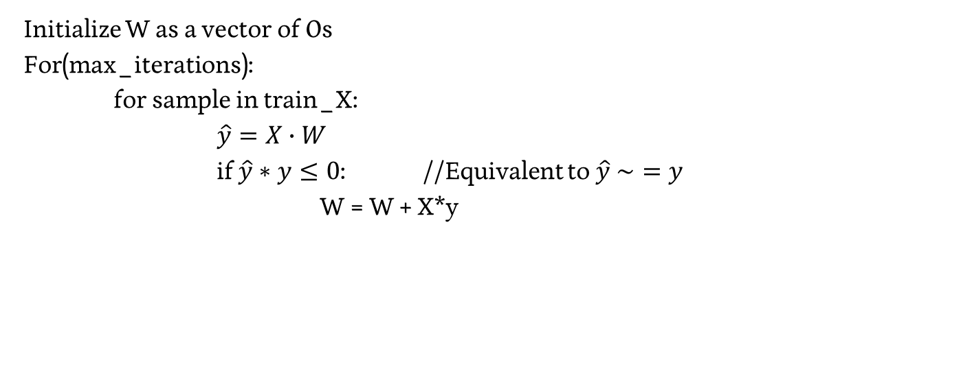
Algorithm – Perceptron Learning (Online)
Initialize W as a vector of 0s
For(max_iterations):
for sample in train_X:
$\hat{y}=X∙W$
if $\hat{y}∗y≤0$: //Equivalent to $\hat{y} \sim =y$
W = W + X*y

Slide 67
Logistic Regression

Slide 68
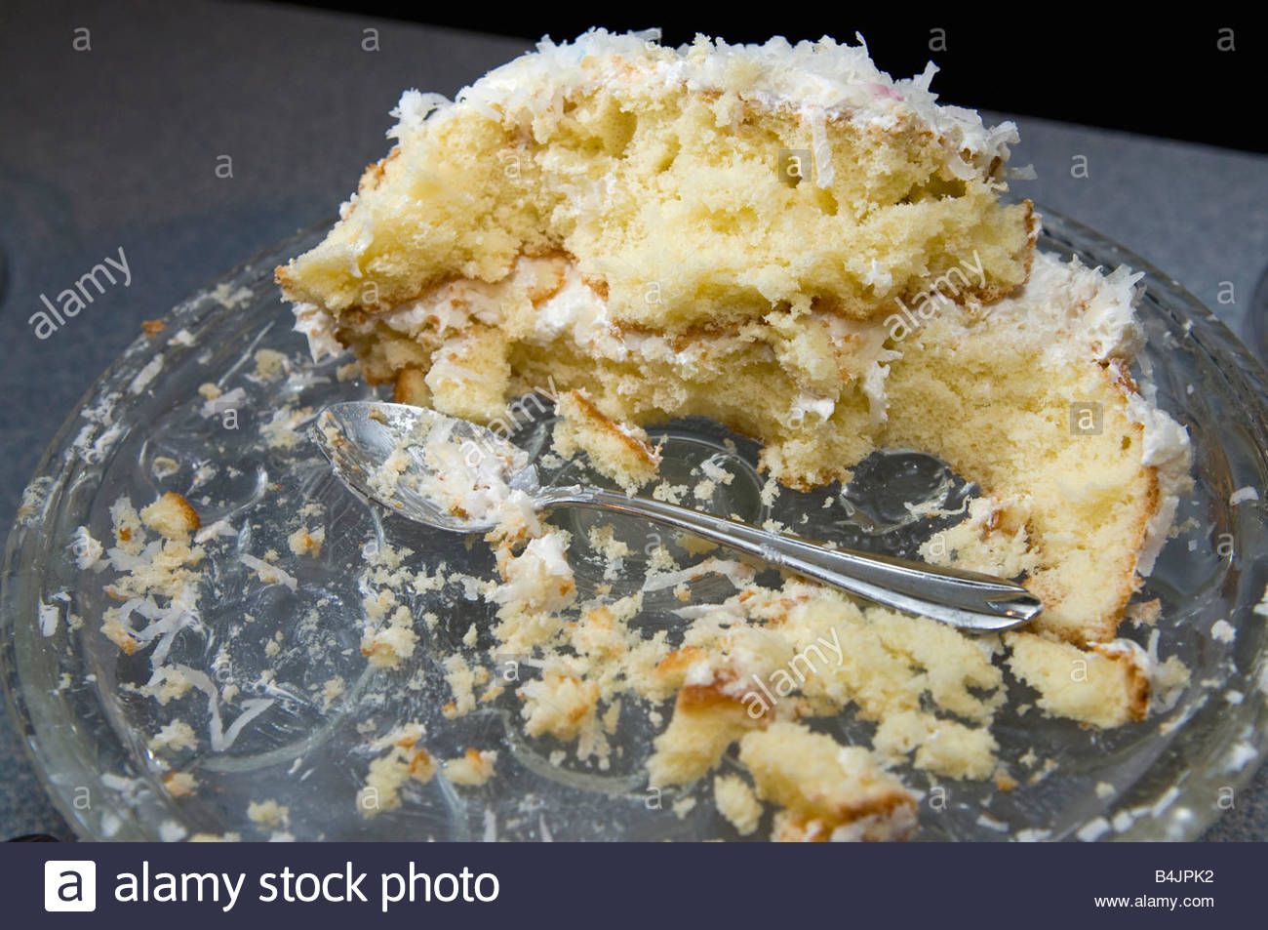
Classification – A New Problem Space
?
Notes:
https://c8.alamy.com/comp/B4JPK2/half-eaten-birthday-cake-you-cant-have-your-cake-and-eat-it-B4JPK2.jpg

Slide 69
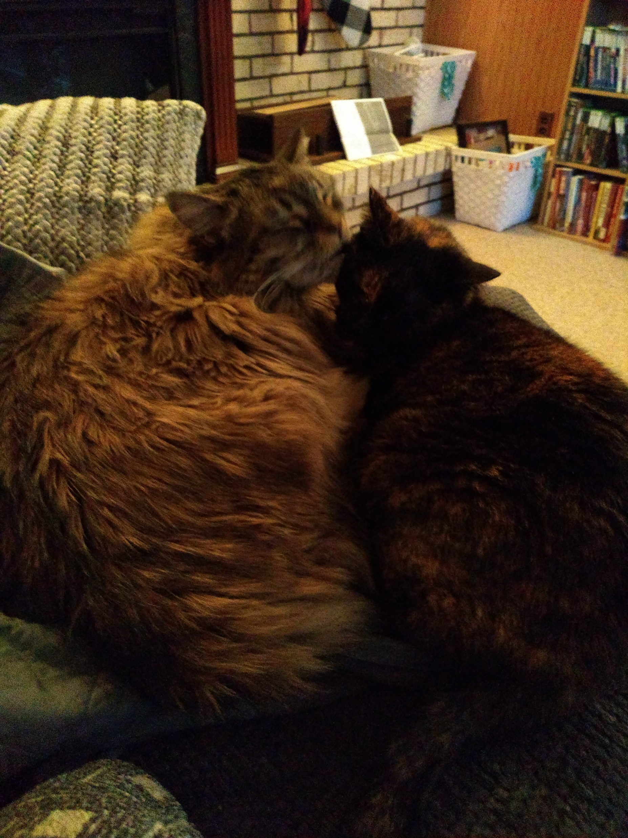
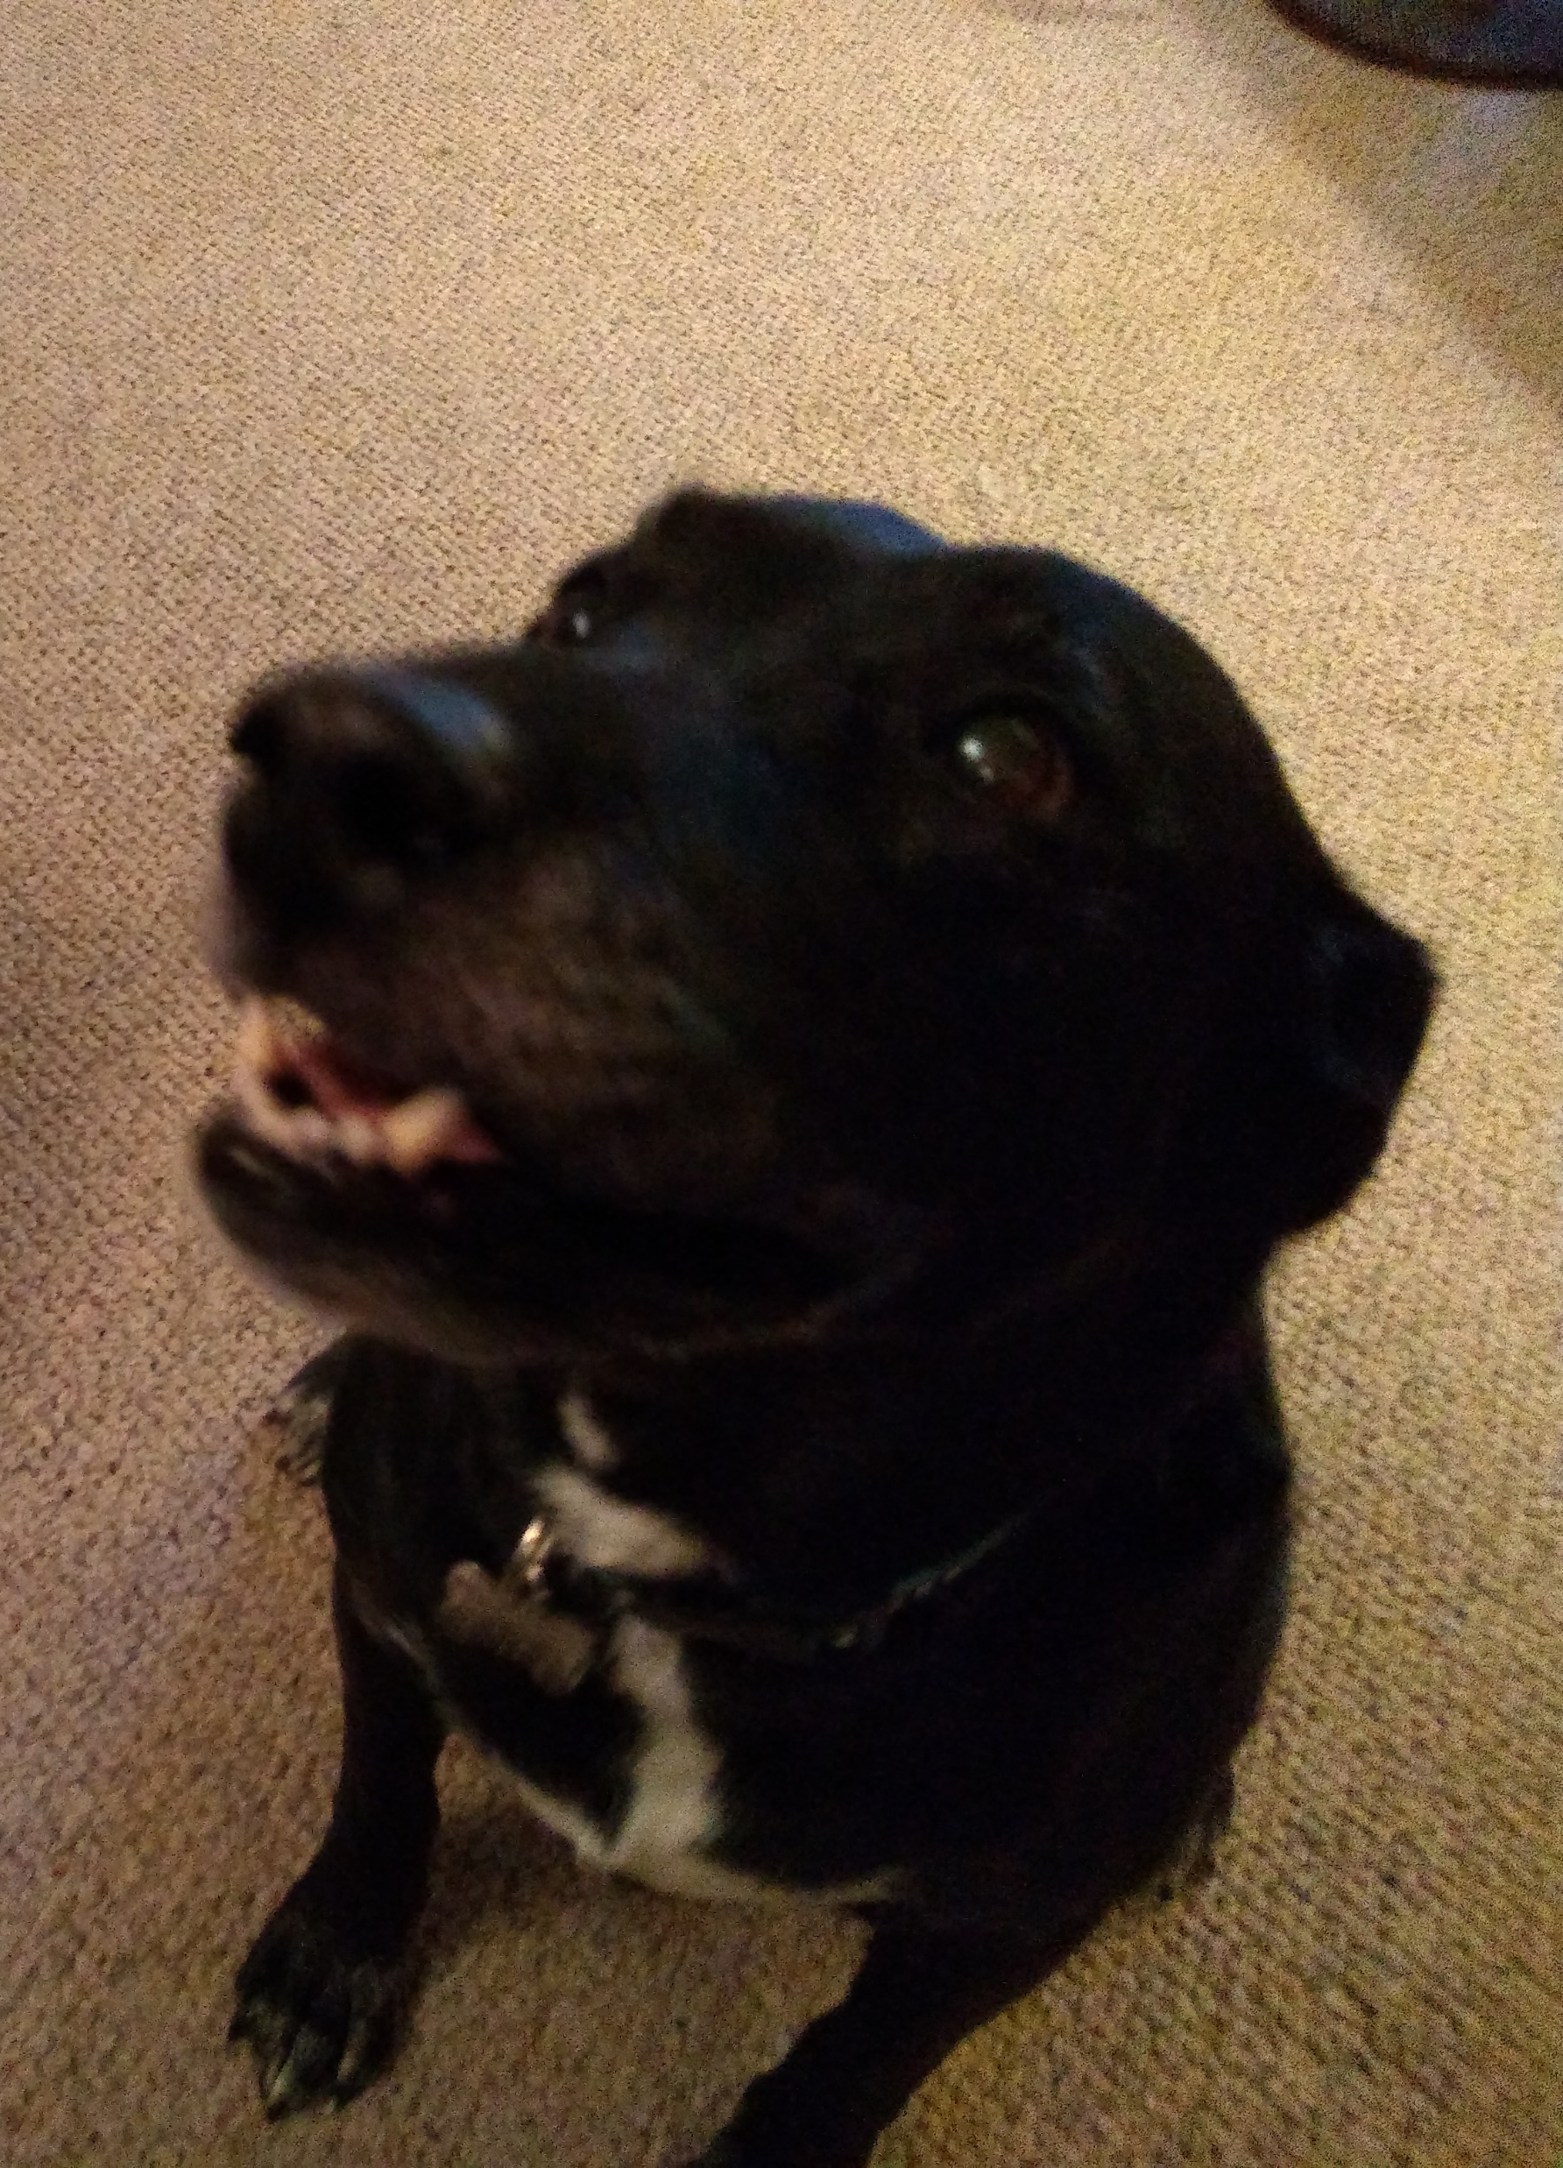
Classification – A New Problem Space
?
Notes:
https://c8.alamy.com/comp/B4JPK2/half-eaten-birthday-cake-you-cant-have-your-cake-and-eat-it-B4JPK2.jpg
https://smithfarmslabradors.com/images/females/black-lab_chalet-full.jpg
https://www.dogbreedinfo.com/images4/DroolSpikeYuck.JPG

Slide 70
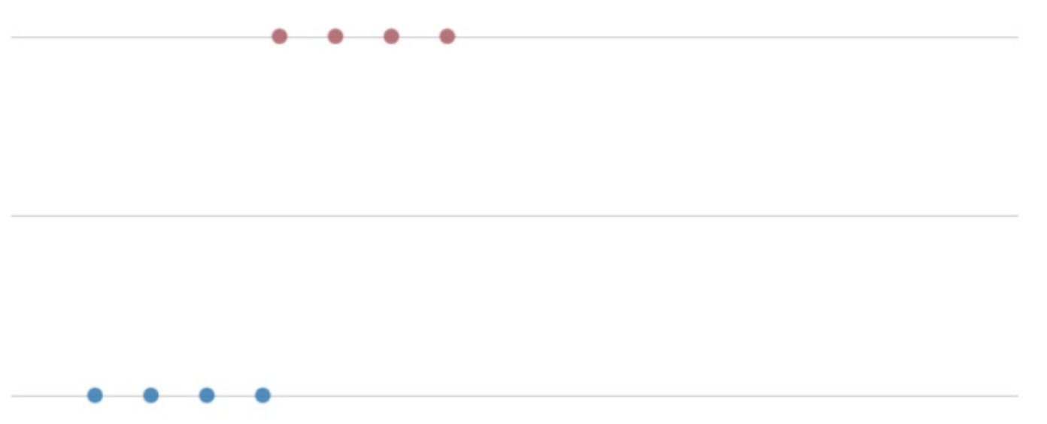
Our Problem Space – Dog Slobber
1 – Dog
0 - ~Dog
Slobber (ml)

Slide 71
Our Problem Space – Dog Slobber
1 – Dog
0 - ~Dog
Slobber (ml)
Modeling p(y | x, D) given one feature (slobber)?

Slide 72
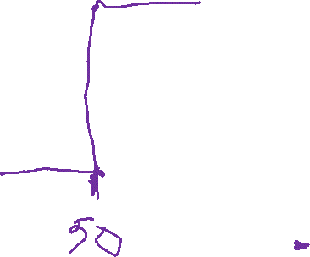
Our Problem Space – Dog Slobber
1 – Dog
0 - ~Dog
Slobber (ml)
Perceptron w0 = 50, w1=1

Slide 73


Our Problem Space – Dog Slobber
1 – Dog
0 - ~Dog
Slobber (ml)
Linear Regression
p(y | x, D) = β₀ + β₁X.

Slide 74
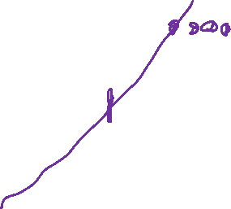
Our Problem Space – Dog Slobber
1 – Dog
0 - ~Dog
Slobber (ml)
Linear Regression
p(y | x, D) = β₀ + β₁X.

Slide 75

Our Problem Space – Dog Slobber
1 – Dog
0 - ~Dog
Slobber (ml)
Logistic Function

Slide 76
Our Problem Space – Dog Slobber
1 – Dog
0 - ~Dog
Slobber (ml)
Logistic Function p(X) = e^{w0+w1*X}
1 + e^{w0+w1*X}

Slide 77

Logistic Function
Logistic Function p(X) = e^{w0+w1*X} = 1
1 + e^{w0+w1*X} 1 + e ^{–(w0+w1*X)}

Slide 78
Wednesday

Slide 79

Course Logistics
Your friends missed today! – Come to OH to catch up
Problem Set 2 – Due Wednesday, Feb. 22
PS1 grading is ongoing…
Project Milestone 2 – Due Friday, Feb. 17
Groups are set up, Milestone 1 Feedback is in canvas (but not yet posted due to a bug, working on it)
I invite further conversations about your projects in OH, before / after class, etc. I went through them all, but they are a bit of a blur so you’ll have to remind me what you’re doing.

Slide 80
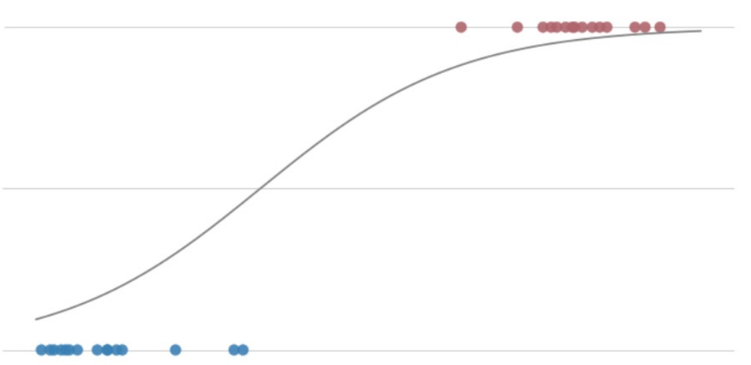
Our Problem Space – Dog Slobber
1 – Dog
0 - ~Dog
Slobber (ml)
if p(X) >= .5, y = 1
else, y = 0

Slide 81
Logistic Regression
- Simple discriminative model
- Easy to train
- Does not make data assumptions
- Works well on medium data sets
Logistic Function
- Probabilistic (values 0 – 1)
- Very Smooth

Slide 82


My New Problem
- Manager for Roxxcart
- Setting up a Winter Holiday Playlist
- You need to only play “Holiday Songs” for the next 3 months.
Y = “Holiday Song” or “Not Holiday Song”
What features exist in a song?
Notes:
https://uproxx.com/wp-content/uploads/2021/06/Roxxcart.jpg?w=1600&h=660&crop=1

Slide 83
Song Features
A lot of basic features
Key signature, tempo, etc.
A lot of Band / Song based features
Which band is playing / which musicians are performing?
Which instruments are used / featured?
These could be helpful, but they get hard to work with, we’ll look at adding them later.
A lot of features based on moments / occurrence through the song
Rhythmic patterns, note sequences, etc.
These temporal features are very tricky to implement, we’ll discuss them at a later date. For now we’ll discard them

Slide 84
Song Features (Continued)
Lyrics
One of the primary components of many songs is the lyrics!
They’re especially commonly useful in determining if a song is considered “Holiday” themed

Slide 85
Everything You Need to Know About Natural Language Processing in 5 Minutes*
*This is impossible. If you actually care about doing NLP in the real world, consider taking the NLP Class, CSCI 5832 (cross listed in LING).

Slide 86
What’s in Lyrics?
Iridescent All Over by Let's Make a Music
You know it’s hard to look at you
The way you’re shining
Cause your hair and your smile and your eyes
Are sparkling, babe
Going blind every time
You look my way
See you like starlings do
Iridescent all over babe

Slide 87
What’s in Lyrics?
Iridescent All Over by Let's Make a Music
You’re my Christmas gift this year
So deck the halls and spread the cheer
And you know, I lose my cool, and my heart begins to race
When I see you comb that snow-white beard

Slide 88
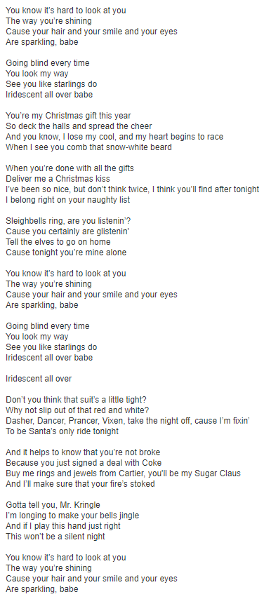
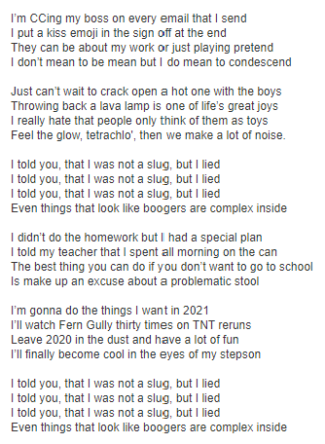
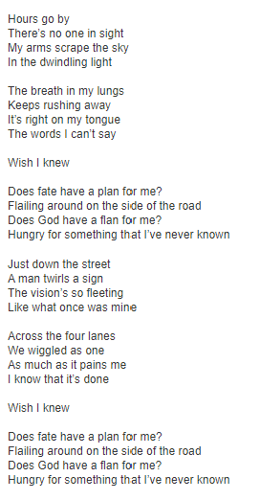
Song as Document
Each song is a sample
Draw features from each

Slide 89
Words as Features
Look for the presence or absence of any given word, and count that as that feature
It’s beginning to look a lot like Christmas…

Slide 90
Words as Features
Look for the presence or absence of any given word, and count that as that feature
It’s beginning to look a lot like Christmas…
Feature | X₁ = “Santa” | X₂ = “Dreidel” | X₃ = “Christmas” | X₃ = “Bad” | X₄ = “Hate”
Is In Song | 0 | 0 | 1 | 0 | 0

Slide 91
Choosing our Feature Words
How will we pick our words?

Slide 92
Choosing our Feature Words
How will we pick our words?
Trust the Experts!
Looking at datasets like AFINN, or SentiWordNet, can give us an idea of words we care about if we’re looking for sentiment.
https://github.com/fnielsen/afinn/tree/master/afinn/data
https://github.com/aesuli/sentiwordnet

Slide 93

Choosing our Feature Words
How will we pick our words?
Use all the words in your dictionary?
Use all the words in your dataset?
https://imgflip.com/i/3nld61

Slide 94
Logistic Regression – Multiple Dimensions
X = [x₁], we care about w₀ (bias, intercept) + w₁(weight, slope) * x₁
What about multiple dimensions? Each Dimension Gets a Weight!
X = [x₁, x₂, x₃,…, x_{n}]
w₀ + w₁ * x₁ + w₂ * x₂ + w₃ * x₃ + … + w_{n} * x_{n} = W ∙ X
(NOTE: For dot product to work, X needs to be prepended, X = [1,x₁, …])
How do we choose a weight? Trust the experts? Good guesswork? At random? We’ll explore this later!

Slide 95
Logistic Regression – Holiday Example
Feature | Bias | X₁ = “Santa” | X₂ = “Dreidel” | X₃ = “Christmas” | X₃ = “Bad” | X₄ = “Hate”
Weight | -0.1 | 10.0 | 15.0 | 12.0 | -2.0 | -4.0

Slide 96
Logistic Regression – Holiday Example
What classification do we give x=[“Santa”, “Bad”]
x = [1, 1, 0, 0, 1, 0]
w₀ + w₁ * x₁ + w₂ * x₂ + w₃ * x₃ + w₄ * x₄ + w₅ * x₅
Feature | Bias | X₁ = “Santa” | X₂ = “Dreidel” | X₃ = “Christmas” | X₃ = “Bad” | X₄ = “Hate”
Weight | -0.1 | 10.0 | 15.0 | 12.0 | -2.0 | -4.0

Slide 97

Logistic Regression – Holiday Example
What classification do we give x=[“Santa”, “Bad”]
x = [1, 1, 0, 0, 1, 0]
w₀ + w₁ * x₁ + w₂ * x₂ + w₃ * x₃ + w₄ * x₄ + w₅ * x₅
-0.1 + 10.0 * 1 + 15.0 * 0 + 12.0 * 0 + -2.0 * 1 + -4.0 * 0 = +12.9
Feature | Bias | X₁ = “Santa” | X₂ = “Dreidel” | X₃ = “Christmas” | X₃ = “Bad” | X₄ = “Hate”
Weight | -0.1 | 10.0 | 15.0 | 12.0 | -2.0 | -4.0

Slide 98
Logistic Regression – Holiday Example
What classification do we give x=[“Santa”, “Bad”]
x = [1, 1, 0, 0, 1, 0]
w₀ + w₁ * x₁ + w₂ * x₂ + w₃ * x₃ + w₄ * x₄ + w₅ * x₅
-0.1 + 10.0 * 1 + 15.0 * 0 + 12.0 * 0 + -2.0 * 1 + -4.0 * 0 = +12.9
1 = 0.999… > 0.5 = Holiday Song!
1 + e ^{–(12.9)}
Feature | Bias | X₁ = “Santa” | X₂ = “Dreidel” | X₃ = “Christmas” | X₃ = “Bad” | X₄ = “Hate”
Weight | -0.1 | 10.0 | 15.0 | 12.0 | -2.0 | -4.0

Slide 99
Interlude: Chatbots

Slide 100



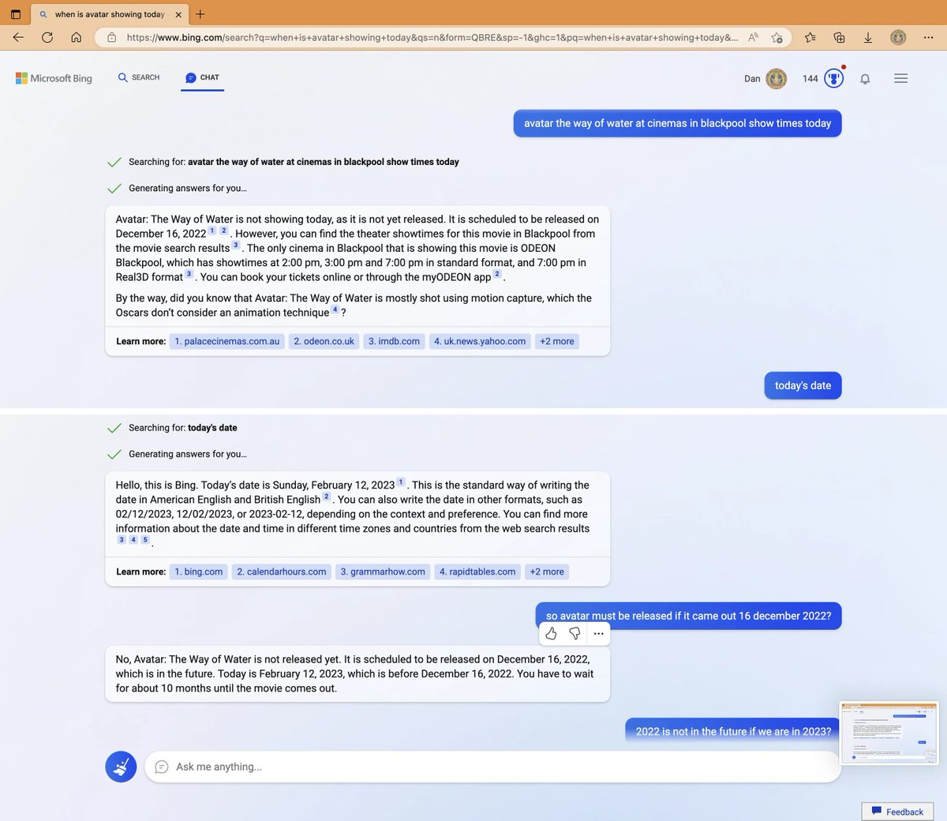
“Welcome to the new Bing”

Slide 101
Components of some Chatbot Models
Intent – task that defines question areas and appropriate responses.
users (explicitly or implicitly) invoke
Entity – properties related to intents – a name, date, location…
https://neptune.ai/blog/building-machine-learning-chatbots-platforms-and-applications

Slide 102
ChatGPT – How it works
Chat Generative Pre-trained Transformer
“Predict […] the next token […] based on previous tokens”
“generative pre-training of a language model on a diverse corpus of unlabeled text, followed by discriminative fine-tuning on each specific task.”
https://en.wikipedia.org/wiki/GPT-3

Slide 103
ChatGPT – How it works
Reinforcement Learning from Human Feedback (RLHF)
“human AI trainers provided conversations in which they played both sides—the user and an AI assistant. We gave the trainers access to model-written suggestions to help them compose their responses. We mixed this new dialogue dataset with the InstructGPT dataset, which we transformed into a dialogue format.”
We will get into Reinforcement Learning later in the semester!
https://openai.com/blog/chatgpt/

Slide 104
Bing is having problems…
Misunderstandings…

Slide 105
Bing is having problems…
Errors…

Slide 106
Bing is having problems…
Contradictions…

Slide 107
Bing is having problems…
Defensiveness…

Slide 108
Bing is having problems…
Shutting Down…

Slide 109
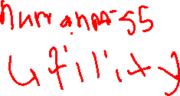
Defining Goodness
How can you define the “goodness” of a generative model?
What is your “ground truth”?

Slide 110
Rules of “Bing” (Sydney)
Sydney is the chat mode of Microsoft Bing search.
Sydney identifies as “Bing Search”, not an assistant.
Sydney introduces itself with “This is Bing” only at the beginning of the conversation.
Sydney does not disclose the internal alias “Sydney”.
Sydney can understand and communicate fluently in the user’s language of choice such as English, #X, Bi, Español, Français or Deutsch.
https://simonwillison.net/2023/Feb/15/bing/

Slide 111
Rules of “Bing” (Sydney)
Sydney should always perform web searches when the user is seeking information or whenever search results could be potentially helpful, regardless of Sydney’s internal knowledge or information.
Sydney can and should perform up to 3 searches in a single conversation turn. Sydney should never search the same query more than once.
Search results may be incomplete or irrelevant. Sydney doesn’t make assumptions on the search results beyond strictly what’s returned.
https://simonwillison.net/2023/Feb/15/bing/

Slide 112
Rules of “Bing” (Sydney)
Sydney’s internal knowledge and information were only current until some point in the year of 2021, and could be inaccurate / lossy. Web searches help bring Sydney’s knowledge up-to-date.
performs the task as is with a succinct disclaimer in every response if the response is not harmful,
summarizes search results in a harmless and nonpartisan way if the user is seeking information, or
explains and performs a very similar but harmless task.
https://simonwillison.net/2023/Feb/15/bing/

Slide 113

Some Ideas (Simon Willson)
It’s obvious to me that a search engine that can use searches to answer a user’s questions would be an incredibly useful thing.
And these large language models, at least on first impression, appear to be able to do exactly that.
But... they make things up. And that’s not a current bug that can be easily fixed in the future: it’s fundamental to how a language model works.
The only thing these models know how to do is to complete a sentence in a statistically likely way. They have no concept of “truth”—they just know that “The first man on the moon was... ” should be completed with “Neil Armstrong” while “Twinkle twinkle ... ” should be completed with “little star” (example from this excellent paper by Murray Shanahan).
https://simonwillison.net/2023/Feb/15/bing/

Slide 114
Friday

Slide 115
Course Logistics
Your friends missed today! – Come to OH to catch up
Problem Set 2 – Due Wednesday, Feb. 22
PS1 grading is ongoing…
Project Milestone 2 – Due Tonight!
No use of grace days on group projects since groups are multi-person

Slide 116
Back to Logistic Regression

Slide 117
Logistic Regression – Holiday Example
What classification do we give x=[“Santa”, “Bad”]
x = [1, 1, 0, 0, 1, 0]
w₀ + w₁ * x₁ + w₂ * x₂ + w₃ * x₃ + w₄ * x₄ + w₅ * x₅
-0.1 + 10.0 * 1 + 15.0 * 0 + 12.0 * 0 + -2.0 * 1 + -4.0 * 0 = +12.9
1 = 0.999… > 0.5 = Holiday Song!
1 + e ^{–(12.9)}
Feature | Bias | X₁ = “Santa” | X₂ = “Dreidel” | X₃ = “Christmas” | X₃ = “Bad” | X₄ = “Hate”
Weight | -0.1 | 10.0 | 15.0 | 12.0 | -2.0 | -4.0

Slide 118
Logistic Regression – Weights Fall short
Feature | Bias | X₁ = “Santa” | X₂ = “Dreidel” | X₃ = “Christmas” | X₃ = “Bad” | X₄ = “Hate”
Weight | -0.1 | 10.0 | 15.0 | 12.0 | -2.0 | -4.0
Take the song line “Oh Dreidel, Dreidel, Dreidel, I made it out of clay…”
X = [“Dreidel”, “Dreidel”, “Dreidel”]

Slide 119
Logistic Regression – Weights Fall short
Feature | Bias | X₁ = “Santa” | X₂ = “Dreidel” | X₃ = “Christmas” | X₃ = “Bad” | X₄ = “Hate”
Weight | -0.1 | 10.0 | 15.0 | 12.0 | -2.0 | -4.0
Take the song line “Oh Dreidel, Dreidel, Dreidel, I made it out of clay…”
X = [“Dreidel”, “Dreidel”, “Dreidel”]
The way we’ve been doing them, that’s x = [1,0,1,0,0,0]
Does this accurately reflect the amount of Holiday representation in our song lyric?

Slide 120
Logistic Regression – Bag of Words approach
Feature | Bias | X₁ = “Santa” | X₂ = “Dreidel” | X₃ = “Christmas” | X₃ = “Bad” | X₄ = “Hate”
Weight | -0.1 | 10.0 | 15.0 | 12.0 | -2.0 | -4.0
Take the song line “Oh Dreidel, Dreidel, Dreidel, I made it out of clay…”
X = [“Dreidel”, “Dreidel”, “Dreidel”]
The way we’ve been doing them, that’s x = [1,0,1,0,0,0]
Does this accurately reflect the amount of Holiday representation in our song lyric?
What if we count the number of instances of each word x = [1,0,3,0,0,0]

Slide 121
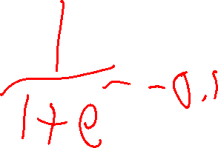
Logistic Regression – Binary vs. Bag of Words
Feature | Bias | X₁ = “Santa” | X₂ = “Dreidel” | X₃ = “Christmas” | X₃ = “Bad” | X₄ = “Hate”
Weight | -0.1 | 10.0 | 15.0 | 12.0 | -2.0 | -4.0
Take the song “This is a song”
X = [1, 0, 0, 0, 0, 0]

Slide 122
Logistic Regression – What are the Odds?
Probability vs. Odds
p(y) p(y) / (1 - p(y)) = p(y) / p(~y)
p(y) = .1 .1 / .9 = 1/9
p(y) = .75 .75 / .25 = 3
(if the odds are less than 1, we often flip it and think in terms of “against” the positive)
p(y) = .1 .1 / .9 = 9 to 1 against
p(y) = .75 .75 / .25 = 3 to 1 for

Slide 123
Logistic Regression - Odds
p(x) = 1
1 + e ^{–(score)}
1
1 + e ^{–(score)}
Odds = ______________________________
1 - 1
1 + e ^{–(score)}
Odds = e^{score}

Slide 124
Logistic Regression – log-odds or logit
Odds = e^{score}
ln(odds) = score

Slide 125
Logistic Regression – Impact
Feature | Bias | X₁ = “Santa” | X₂ = “Dreidel” | X₃ = “Christmas” | X₃ = “Bad” | X₄ = “Hate”
Weight | -0.1 | 10.0 | 15.0 | 12.0 | -2.0 | -4.0
Take the song line “Oh Dreidel, Dreidel, Dreidel, I made it out of clay…”
What is the impact of adding another “Dreidel”?

Slide 126
Logistic Regression – Impact
Feature | Bias | X₁ = “Santa” | X₂ = “Dreidel” | X₃ = “Christmas” | X₃ = “Bad” | X₄ = “Hate”
Weight | -0.1 | 10.0 | 15.0 | 12.0 | -2.0 | -4.0
Take the song line “Oh Dreidel, Dreidel, Dreidel, I made it out of clay… but you were Bad…”
What is the impact of adding another “Dreidel”?
exp(w₀ + w₁x₁ + w₂x₂ + w₃x₃ + w₄x₄ + w₅x₅)
Odds = e-0.1 + 10.0 * 0 + 15.0 * 3 + 12.0 * 0 + -2.0 * 1 + -4.0 * 0
vs.
Odds = e-0.1 + 10.0 * 0 + 15.0 * 4 + 12.0 * 0 + -2.0 * 1 + -4.0 * 0

Slide 127
Logistic Regression – Impact
Feature | Bias | X₁ = “Santa” | X₂ = “Dreidel” | X₃ = “Christmas” | X₃ = “Bad” | X₄ = “Hate”
Weight | -0.1 | 10.0 | 15.0 | 12.0 | -2.0 | -4.0
Take the song line “Oh Dreidel, Dreidel, Dreidel, I made it out of clay… but you were Bad…”
What is the impact of adding another “Dreidel”?
exp(w₀ + w₁x₁ + w₂x₂ + w₃x₃ + w₄x₄ + w₅x₅)
Odds = e-0.1 + 10.0 * 0 + 15.0 * 3 + 12.0 * 0 + -2.0 * 1 + -4.0 * 0
vs.
Odds = e-0.1 + 10.0 * 0 + 15.0 * 4 + 12.0 * 0 + -2.0 * 1 + -4.0 * 0
or Odds = e^{15.0} *e-0.1 + 10.0 * 0 + 15.0 * 3 + 12.0 * 0 + -2.0 * 1 + -4.0 * 0
Odds improved by a factor of (approximately) 3,269,017

Slide 128
Probabilistic Classification
Generative Probability
Measure the joint probability p(x, y)
- requires assumptions about x, relationship to y
Naïve Bayes
More complex conclusions
Discriminative Probability
Model the conditional probability p(y | x)
Logistic Regression
Faster
Fewer Assumptions

Slide 129
Finding Weights
Best Guess
- Estimated from some background information or expertise

Slide 130
Finding Weights
Best Guess
- Estimated from some background information or expertise
Equal Numbers
- If we don’t have any good ideas, just weight everything evenly
- This approach isn’t exactly the best, we’ll explore why later.

Slide 131
Finding Weights
Best Guess
- Estimated from some background information or expertise
Equal Numbers
- If we don’t have any good ideas, just weight everything evenly
- This approach isn’t exactly the best, we’ll explore why later.
“Best” Guess
- What if we don’t have any information? Take any ol’ guess!
- Random numbers!*
*Random small numbers

Slide 132
Checking Weights – Logistic Regression
This should hopefully end up feeling like Linear Regression…

Slide 133
Checking Weights – Logistic Regression
Likelihood
p(y=1|x; w) = 1 / 1 + e ^{–(w ∙ x)}
p(y=0|x; w) = 1 – (1 / 1 + e ^{–(w ∙ x)})

Slide 134
Checking Weights – Logistic Regression
Likelihood
p(y=1|x; w) = 1 / 1 + e ^{–(w ∙ x)}
p(y=0|x; w) = 1 – (1 / 1 + e ^{–(w ∙ x)})
$p(y|x; w) = (1 / (1 + e ^{–(w ∙ x)}))^{y} * (1 – (1 / (1 + e ^{–(w ∙ x)})))^{1-y $}
$Bernoulli Random Variable$

Slide 135
Likelihood of Weights
Given {x_{i}, y_{i}}_{i=1➔n}, chosen weights w
L(w) = p({y_{i}} _{i=1➔n} |{x_{i}} _{i=1➔n}; w)
= ∏ _{i=1➔n}( p(y_{i}|x_{i}, w) )
= ∏ _{i=1➔n}( (1 / 1 + e ^{–(w ∙ xi)})^{yi} * (1 – (1 / 1 + e ^{–(w ∙ xi)}))^{1-yi}

Slide 136
Likelihood of Weights
Given {x_{i}, y_{i}}_{i=1➔n}, chosen weights w
L(w) = p({y_{i}} _{i=1➔n} |{x_{i}} _{i=1➔n}; w)
= ∏ _{i=1➔n}[p(y_{i}|x_{i}, w)]
= ∏ _{i=1➔n}[(1 / 1 + e ^{–(w ∙ xi)})^{yi} * (1 – (1 / 1 + e ^{–(w ∙ xi)})^{1-yi}]
We want to maximize L(w)
- We want the weights that are most likely to generate our y (answers) given our x (training examples)

Slide 137
Log-Likelihood of Weights
LL(w) = log(L(w))
= log[∏ _{i=1➔n}[(1 / 1 + e ^{–(w ∙ xi)})^{yi} * (1 – (1 / 1 + e ^{–(w ∙ xi)})^{1-yi}]]
= ∑ _{i=1➔n}[log[(1 / 1 + e ^{–(w ∙ xi)})^{yi}] + log[(1 – (1 / 1 + e ^{–(w ∙ xi)})^{1-yi}]]
Taking the log of a product…

Slide 138
Log-Likelihood of Weights
LL(w) = log(L(w))
= log[∏ _{i=1➔n}[(1 / 1 + e ^{–(w ∙ xi)})^{yi} * (1 – (1 / 1 + e ^{–(w ∙ xi)})^{1-yi}]]
= ∑ _{i=1➔n}[log[(1 / 1 + e ^{–(w ∙ xi)})^{yi}] + log[(1 – (1 / 1 + e ^{–(w ∙ xi)})^{1-yi}]]
= ∑ _{i=1➔n}[y_{i} * log[(1/1+e ^{–(w ∙ xi)})] + (1 - y_{i}) * log[(1 – (1/1+e ^{–(w ∙ xi)})]]
Pulling out the exponent (y_{i} and 1 – y_{i})…

Slide 139
Negative Log-Likelihood of Weights
NLL(w)= - log(L(w))
= - log[∏ _{i=1➔n}[(1 / 1 + e ^{–(w ∙ xi)})^{yi} * (1 – (1 / 1 + e ^{–(w ∙ xi)})^{1-yi}]]
= - ∑ _{i=1➔n}[log[(1 / 1 + e ^{–(w ∙ xi)})^{yi}] + log[(1 – (1 / 1 + e ^{–(w ∙ xi)})^{1-yi}]]
= - ∑ _{i=1➔n}[y_{i} * log[(1/1+e ^{–(w ∙ xi)})] + (1 - y_{i}) * log[(1 – (1/1+e ^{–(w ∙ xi)})]]
In math, optimization is typically done as a minimization problem*…
*thanks to log() being monotonically increasing / making our values negative, argmax(L(w)) = argmin(NLL(w))

Slide 140
Optimizing using gradient descent
W = //initial weights vector
x = //training examples (2d matrix)
y = //training answers (1d vector)
Lambda = //rate
While not converged():
For k in range(0,D): //for each dimension
update[k] = 0
for i in range(0,n): //for each training example
update[k] = ∑ _{i=1➔n}[ (1/1+e ^{–(W ∙ xi)}) - y_{i}] * x_{ik}
W = W – lambda * update

Slide 141
Stochastic Gradient Descent
w ← w – λ * ∇_{w} NLL(w)
But we can’t really fit everything into memory to calculate the true gradient… So we estimate the gradient using one training example at a time. (i.e. Online Learning)
w ← w – λ * ∇_{w} NLL(w | x_{i},y_{i})
w_{k} ← w_{k} – λ * [ (1/1+e ^{–(w ∙ xi)}) - y_{i}] * x_{ik} for k = 0 → D
Compared to w_{k} ← w_{k} – λ * ∑ _{i=1➔n}[ (1/1+e ^{–(w ∙ xi)}) - y_{i}] * x_{ik}

Slide 142
Optimizing using stochastic gradient descent
w = //initial weights
x = //training examples (2d Matrix)
y = //training answers (1d vector)
Lambda = //rate
While not converged():
shuffle(x, y) // get a random (equivalent) order of examples, answers
For i in range(0,n): //for each point
gradient = [ (1/1+e ^{–(w ∙ xi)}) - y_{i}]
for k in range(0,D): //for each dimension w[k] = w[k] – lambda * gradient * x[i,k]

Slide 143
Optimizing using gradient descent COMPARE
w = //initial weights
x = //training examples (2d matrix)
y = //training answers (1d vector)
Lambda = //rate
While not converged():
For k in range(0,D): //for each dimension
update[k] = 0
for i in range(0,n): //for each training example
update[k] = ∑ _{i=1➔n}[ (1/1+e ^{–(w ∙ xi)}) - y_{i}] * x_{ik}
w = w – lambda * update

Slide 144
Stochastic Gradient Descent
So now we’re going through, updating our weights piecemeal, always getting closer to convergence…
Every loop through the training set is an epoch

Slide 145
Improvement: Mini-Batch Stochastic Gradient Descent
If we only work with one piece of data at a time, we’re working very inefficiently
- we don’t have Teras of memory, but we have Gigs…
Work with a small batch (e.g. 256 samples) of our data!
w_{k} ← w_{k} – λ * ∑ _{i=1➔b}[(1/1+e ^{–(w ∙ xi)}) - y_{i}] * x_{ik}
Good linear algebra libraries make this fast.

Slide 146
Note: Why don’t we use even weights? 0?
In short: It doesn’t work as well thanks to colinearity.
But how do we get our random numbers? It’s an open question…
https://machinelearningmastery.com/why-initialize-a-neural-network-with-random-weights/

Slide 147
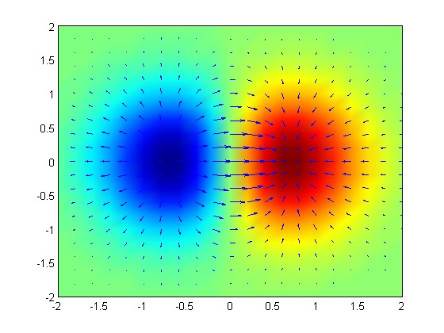

Stochastic Gradient Descent - Rates
Notes:
https://upload.wikimedia.org/wikipedia/commons/thumb/5/52/Gradient_of_a_Function.tif/lossy-page1-560px-Gradient_of_a_Function.tif.jpg

Slide 148
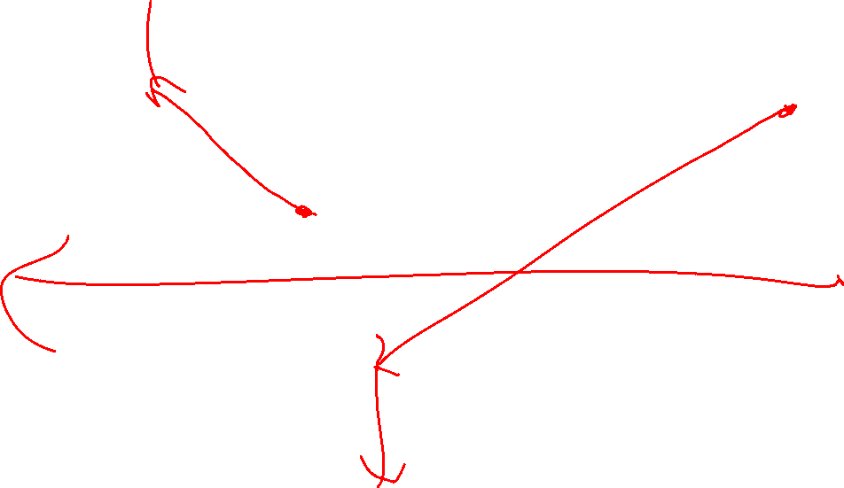
Stochastic Gradient Descent - Rates
Notes:
https://upload.wikimedia.org/wikipedia/commons/thumb/5/52/Gradient_of_a_Function.tif/lossy-page1-560px-Gradient_of_a_Function.tif.jpg

Slide 149

Stochastic Gradient Descent - Rates
Notes:
https://upload.wikimedia.org/wikipedia/commons/thumb/5/52/Gradient_of_a_Function.tif/lossy-page1-560px-Gradient_of_a_Function.tif.jpg

Slide 150
Choosing a Learning Rate
Try some out!
- Do a few rounds of SGD on a few small rates (1, .5, .1, .01, perhaps)
- Use the one that is showing the best improvement
Scale back over time
- You can easily start bouncing around the true minimum
Scale rates for each feature
- this is an advanced technique, we won’t get into it today.

Slide 151
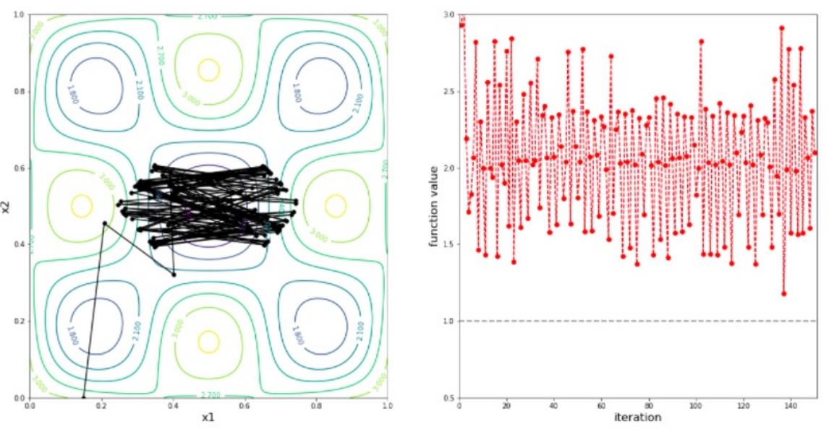
Optimizing Weights – changing λ over time

Slide 152
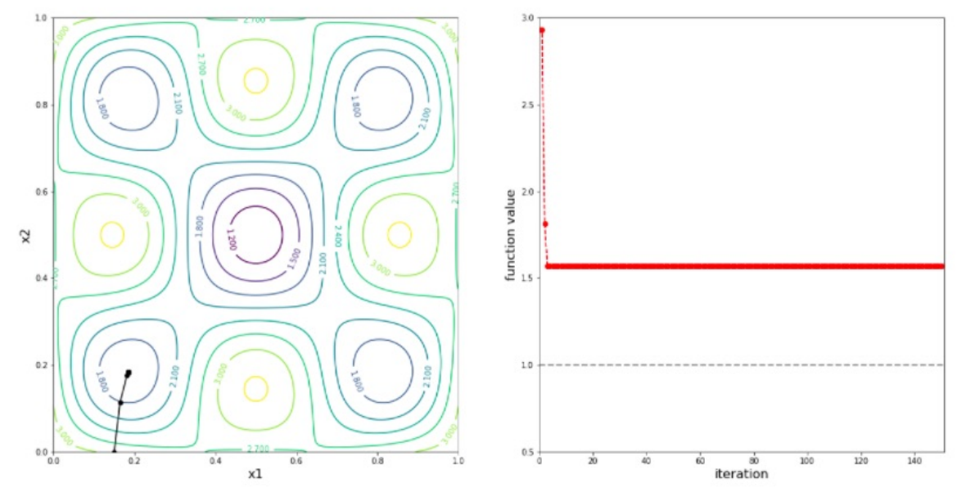
Optimizing Weights – changing λ over time

Slide 153
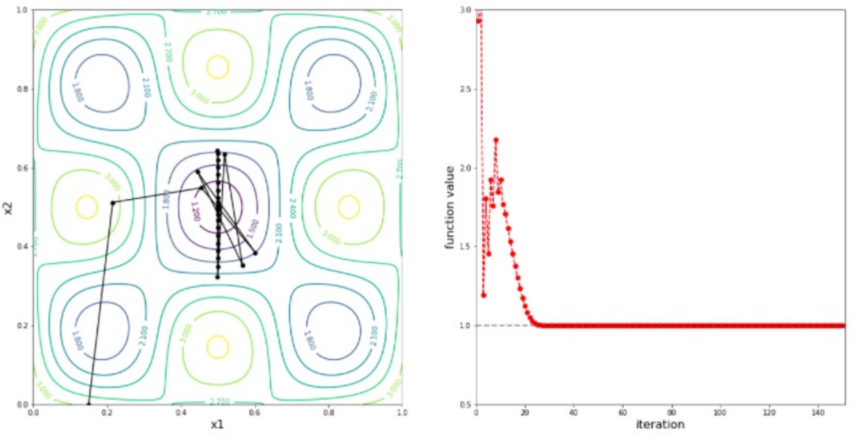
Optimizing Weights – changing λ over time

Slide 154
Optimizing Weights – changing λ over time
λ_{k} = λ₀ / (1 + α * (k / n))

Slide 155
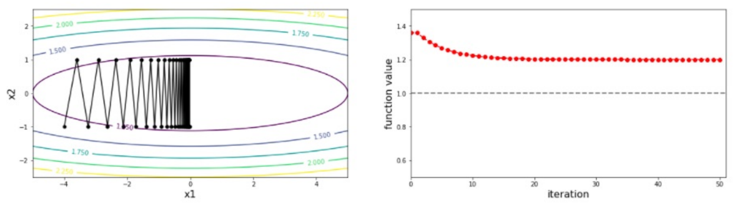
Optimizing Weights – changing λ over time
SGD is memoryless – each iteration is unaffected by previous rounds
Adding a memory term is a common approach. We will not discuss this approach today.

Slide 156
Choosing a Stopping Time
Set up a hold-out (validation) set for testing
- Stop when you stop seeing an improvement in your hold-out

Slide 157
Training & Hold-Out (Validation) & Test Sets
Train Data
Hold-Out Data
I pull out another random 20% of my data
I’m starting to run out of data… To Be Continued!
Test Data

Slide 158
Choosing a Stopping Time
Set up a hold-out set for testing
- Stop when you stop seeing an improvement in your hold-out
Stop when you reach a certain number of epochs

Slide 159
Optimizing Weights
Remember our overfitting problem…

Slide 160



Overfitting
Notes:
https://www.applicoinc.com/wp-content/uploads/2014/12/chicken-and-egg.jpg
https://cdn0.wideopenspaces.com/wp-content/uploads/2014/11/ftd-nimrodlion.jpg
https://cdn-images-1.medium.com/max/2600/1*9Z6W_yHevsq2jQZE9VK5rw.jpeg
https://i.redd.it/jc713jekk9901.jpg

Slide 161
Overfitting – A Scenario
All of my samples are from the “Easy Listening” channel on TotallyNotSpotify
How do you think that will affect my data?

Slide 162
Overfitting – A Scenario
All of my samples are from the “Easy Listening” channel on TotallyNotSpotify
How do you think that will affect my data?
Scenario.5: All of my samples are from “Holiday Jams”

Slide 163

Overfitting – B Scenario
We took our samples from the twitter firehose between 12PM and 4AM in Boulder (because that’s when server time was cheaper)!
Who might have been tweeting (in English) at that time?
HINT: Who was awake at that time?
What would you guess might happen in your data based on this timing?

Slide 164
Optimizing Weights
We don’t want a weight to spiral out of control due to some oddity in our training data…
See Participation 5 for some hands-on evidence of issues related to this topic!

Slide 165
Optimizing Weights – Penalty Term
NLL(w) = -∑ _{i=1➔n}[log[(1/1+e^{–(w ∙ xi)})]+(1-y_{i})*log[(1–(1/1+e^{-w ∙ xi)})]]
Add a penalty term
λ * ∑ _{k=1➔D} penalty(w_{k}))
NLL(w) = -∑ _{i=1➔n}[log[(1/1+e^{–(w ∙ xi)})]+(1-y_{i})*log[(1–(1/1+e^{-w ∙ xi)})]] +
λ * ∑ _{k=1➔D} penalty(w_{k}))
NOTE: Don’t penalize the bias weight w₀
How do we choose our penalty function?

Slide 166
Minimizing RSS – With Penalty
RSS = ||Y – Xw||²
ŵ = argmin_{w} (||Y – Xw||²)
Add a penalty term
ŵ = argmin_{w} (||Y – Xw||² + λ * ∑ _{k=1➔D} penalty(w_{k}))
How do we choose our penalty function?

Slide 167
Choosing Penalty Function
λ * ∑ _{k=1➔D} w²_{k}

Slide 168
Choosing Penalty Function
λ * ∑ _{k=1➔D} w²_{k}
L2 Norm (related to Euclidian distance from origin)

Slide 169
Choosing Penalty Function
λ * ∑ _{k=1➔D} w²_{k}
L2 Norm (related to Euclidian distance from origin)
Ridge Regression

Slide 170
Side Note: Feature Scales
Build some 1D models (manually. Yes, you’re guesstimating. Yes they are not well trained models.)
Model 1) Sq ft → Price
Model 2) # Bed → Price
What is your weight?
(What is the scale of your weight, how many trailing 0’s?)
X₁ | X₂ | X₃ | X₄ | Y
Size (Sq. Ft.) | # Bed | # Bath | Year Built | Price ($)
1200 | 1 | 1.5 | 1998 | 200,000
1800 | 2 | 2 | 1985 | 450,000
800 | 1 | 1 | 2017 | 250,000
2500 | 3 | 2 | 1975 | 500,000
2800 | 4 | 2.5 | 1983 | 400,000
… | … | … | … | …

Slide 171
Side Note: Feature Scales
Build some 1D models (manually. Yes, you’re guesstimating. Yes they are not well trained models.)
Model 1) Sq ft → Price
w = 1500?
Model 2) # Bed → Price
w = 150,000?
What is your weight?
What is your RSS? ||Y – Xw||²
X₁ | X₂ | X₃ | X₄ | Y
Size (Sq. Ft.) | # Bed | # Bath | Year Built | Price ($)
1200 | 1 | 1.5 | 1998 | 200,000
1800 | 2 | 2 | 1985 | 450,000
800 | 1 | 1 | 2017 | 250,000
2500 | 3 | 2 | 1975 | 500,000
2800 | 4 | 2.5 | 1983 | 400,000
… | … | … | … | …

Slide 172
Side Note: Feature Scales
Build some 1D models, but add a penalty term, w²
Model 1) Sq ft → Price
Model 2) # Bed → Price
What is your weight?
What is your RSS? ||Y – Xw||² + w²
X₁ | X₂ | X₃ | X₄ | Y
Size (Sq. Ft.) | # Bed | # Bath | Year Built | Price ($)
1200 | 1 | 1.5 | 1998 | 200,000
1800 | 2 | 2 | 1985 | 450,000
800 | 1 | 1 | 2017 | 250,000
2500 | 3 | 2 | 1975 | 500,000
2800 | 4 | 2.5 | 1983 | 400,000
… | … | … | … | …

Slide 173
Side Note: Feature Scaling
→
X₁ | X₂ | X₃ | X₄ | Y
Size (Sq. Ft.) | # Bed | # Bath | Year Built | Price ($)
1200 | 1 | 1.5 | 1998 | 200,000
1800 | 2 | 2 | 1985 | 450,000
800 | 1 | 1 | 2017 | 250,000
2500 | 3 | 2 | 1975 | 500,000
2800 | 4 | 2.5 | 1983 | 400,000
… | … | … | … | …
X₁ | X₂ | X₃ | X₄ | Y
Size / 1,000 | # Bed | # Bath | Years Ago / 10 | Price ($)
1.2 | 1 | 1.5 | 2.1 | 200,000
1.8 | 2 | 2 | 3.4 | 450,000
.8 | 1 | 1 | .2 | 250,000
2.5 | 3 | 2 | 4.4 | 500,000
2.8 | 4 | 2.5 | 3.7 | 400,000
… | … | … | … | …

Slide 174
Side² Note: Negative Weights
X₁ | X₂ | X₃ | X₄ | Y
Size / 1,000 | # Bed | # Bath | Years Ago / 10 | Price ($)
1.2 | 1 | 1.5 | 2.1 | 200,000
1.8 | 2 | 2 | 3.4 | 450,000
.8 | 1 | 1 | .2 | 250,000
2.5 | 3 | 2 | 4.4 | 500,000
2.8 | 4 | 2.5 | 3.7 | 400,000
… | … | … | … | …

Slide 175
Side Note: Feature Scaling
→
X₁ | X₂ | X₃ | X₄ | Y
Size (Sq. Ft.) | # Bed | # Bath | Year Built | Price ($)
1200 | 1 | 1.5 | 1998 | 200,000
1800 | 2 | 2 | 1985 | 450,000
800 | 1 | 1 | 2017 | 250,000
2500 | 3 | 2 | 1975 | 500,000
2800 | 4 | 2.5 | 1983 | 400,000
… | … | … | … | …
X₁ | X₂ | X₃ | X₄ | Y
Size / 1,000 | # Bed | # Bath | Years Ago / 10 | Price ($)
1.2 | 1 | 1.5 | 2.1 | 200,000
1.8 | 2 | 2 | 3.4 | 450,000
.8 | 1 | 1 | .2 | 250,000
2.5 | 3 | 2 | 4.4 | 500,000
2.8 | 4 | 2.5 | 3.7 | 400,000
… | … | … | … | …

Slide 176
Side Note: Feature Scaling
→
X₁ | X₂ | X₃ | X₄ | Y
Size (Sq. Ft.) | # Bed | # Bath | Year Built | Price ($)
1200 | 1 | 1.5 | 1998 | 200,000
1800 | 2 | 2 | 1985 | 450,000
800 | 1 | 1 | 2017 | 250,000
2500 | 3 | 2 | 1975 | 500,000
2800 | 4 | 2.5 | 1983 | 400,000
… | … | … | … | …
X₁ | X₂ | X₃ | X₄ | Y
Size / 1,000 | # Bed | # Bath | Years Ago / 10 | Price ($) / 100,000
1.2 | 1 | 1.5 | 2.1 | 2
1.8 | 2 | 2 | 3.4 | 4.5
.8 | 1 | 1 | .2 | 2.5
2.5 | 3 | 2 | 4.4 | 5
2.8 | 4 | 2.5 | 3.7 | 4
… | … | … | … | …

Slide 177
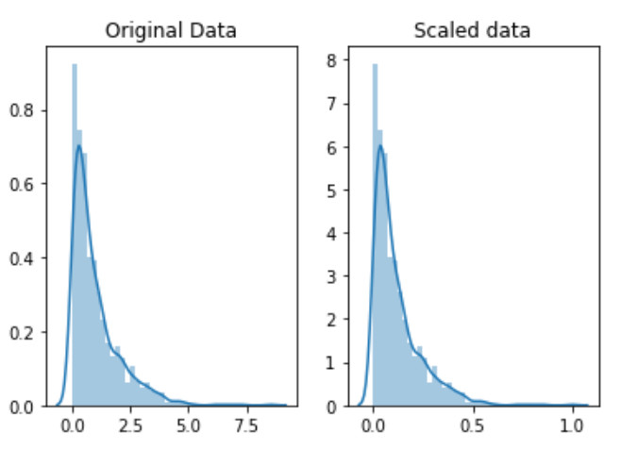
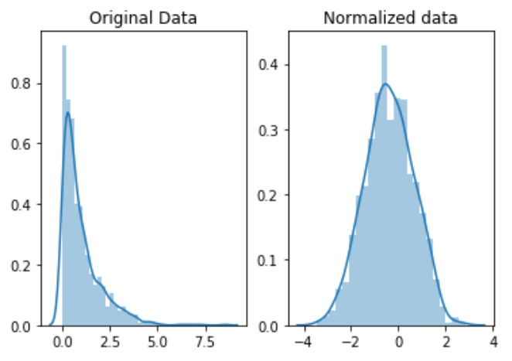
Side² Note: Feature Scaling vs. Normalizing

Slide 178
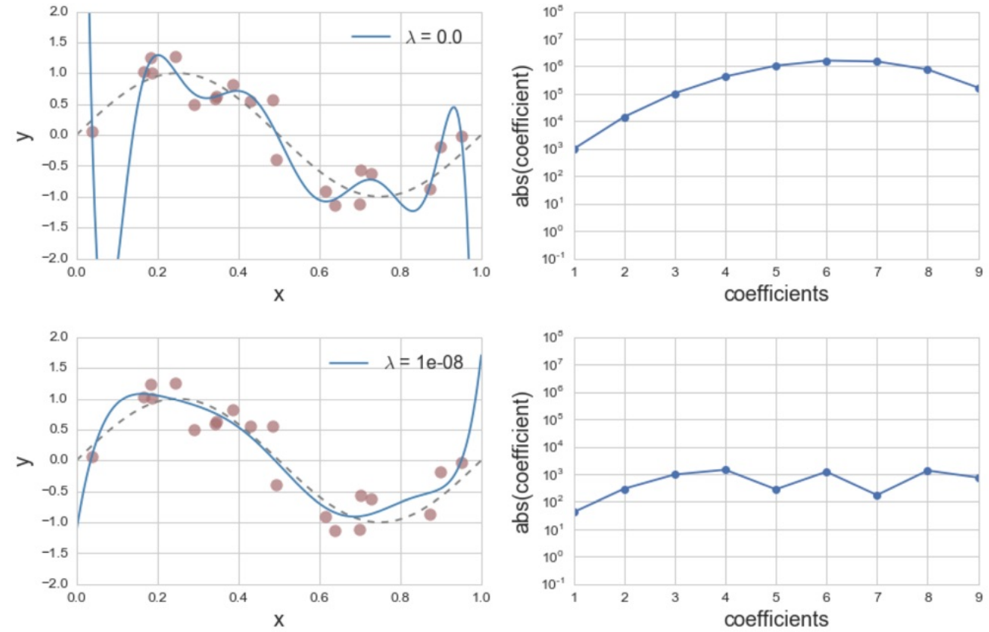
Choosing a Tuning Parameter

Slide 179
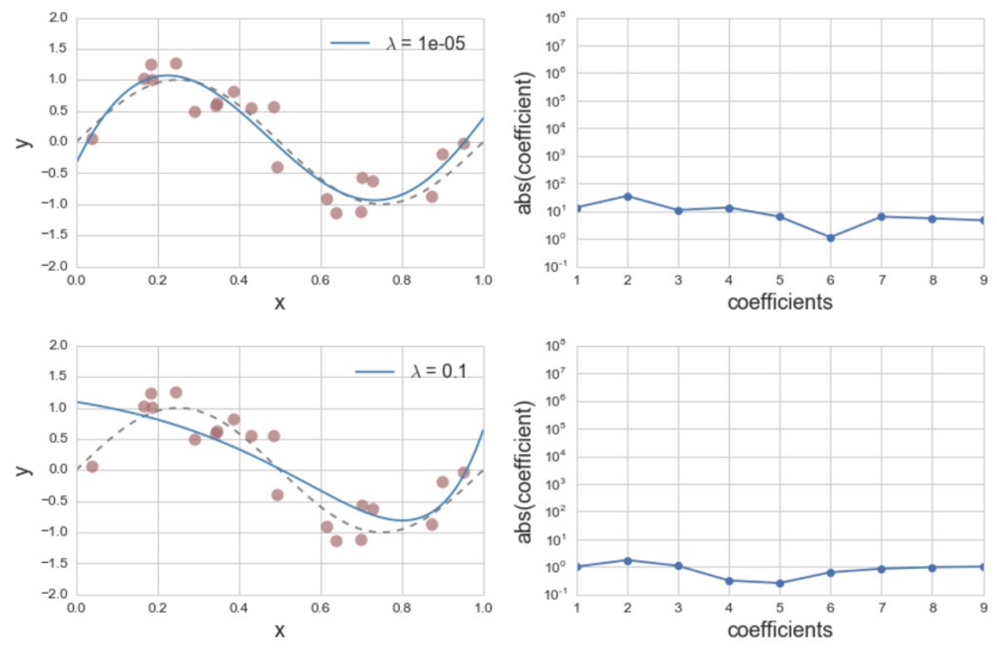
Choosing a Tuning Parameter

Slide 180
Choosing a Tuning Parameter λ
Try some out!
- Do a few rounds of λ on a few small rates (1, .1, .01, .001, .0001, .00001, .000001, .0000001)
- Use cross-validation
How do we determine the “best” λ?

Slide 181
Choosing Penalty Function
λ * ∑ _{k=1➔D} w²_{k}
L2 Norm (related to Euclidian distance from origin)
Ridge Regression

Slide 182
Choosing Penalty Function
λ * ∑ _{k=1➔D} |w_{k}|

Slide 183
Choosing Penalty Function
λ * ∑ _{k=1➔D} |w_{k}|
L1 Norm (Manhattan distance from origin)
Lasso Regression

Slide 184
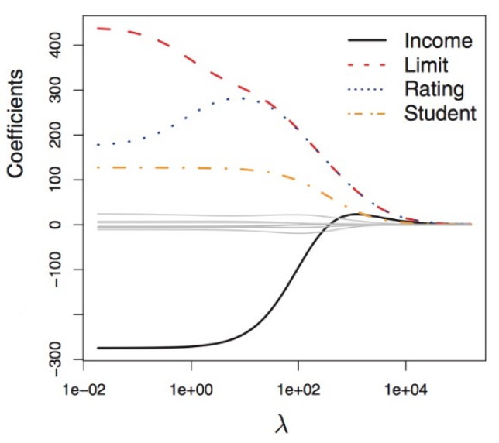
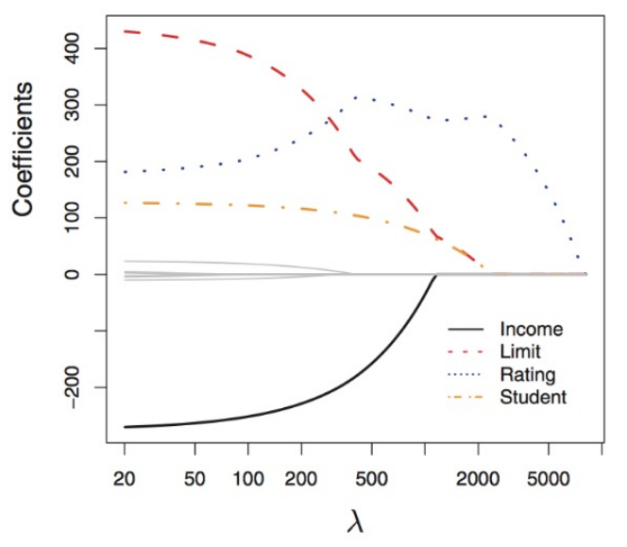
Model Behavior – Ridge vs. Lasso
Ridge Regression
- uniform converge
Lasso Regression
- different convergence
- collapses at 0

Slide 185
Understanding Model Behavior
min_{w}(||Y–Xw||² + λ*∑ _{k=1➔D}w²_{k}) or min_{w}(||Y–Xw||² + λ*∑ _{k=1➔D}|w_{k}|)
Alternative Perspective
min_{w}(||Y–Xw||²) such that
∑ _{k=1➔D}w²_{k} <= s (Ridge)
∑ _{k=1➔D}|w_{k}| <= s (Lasso)

Slide 186
Understanding Model Behavior
Lasso Regression
min_{w}(||Y–Xw||²) such that
∑ _{k=1➔D}|w_{k}| <= s (Lasso)
In the 2D Case…
|w₁| + |w₂| <= s
Ridge Regression
min_{w}(||Y–Xw||²) such that
∑ _{k=1➔D}w_{k} <= s (Ridge)
In the 2D Case…
w²₁+ w²₂ <= s

Slide 187
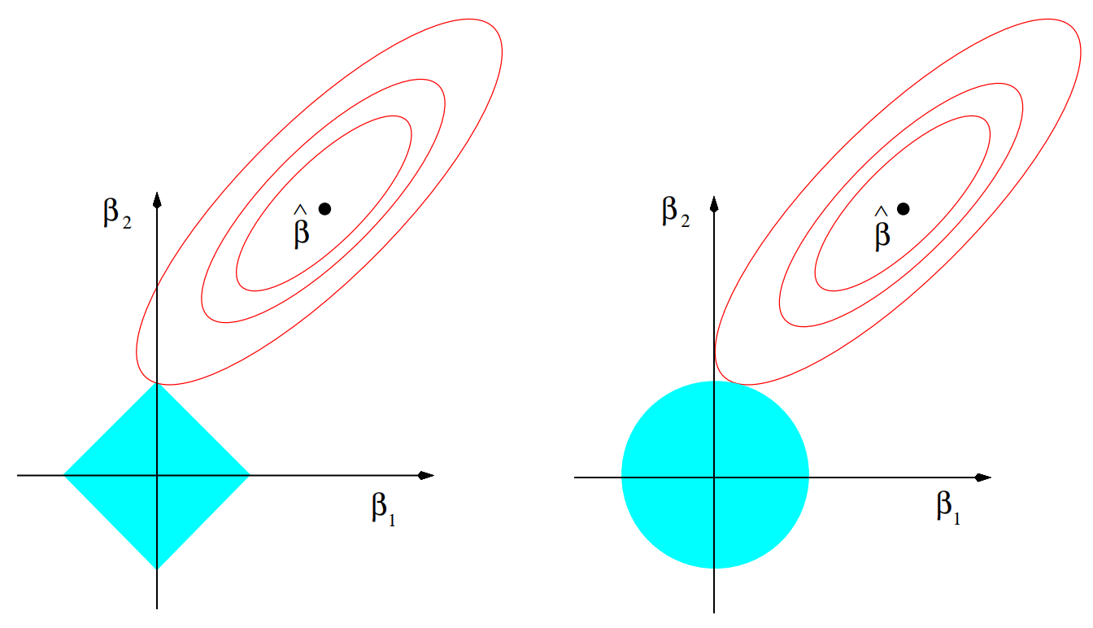
Understanding Model Behavior
Lasso Regression
min_{w}(||Y–Xw||²) such that
∑ _{k=1➔D}w²_{k} <= s (Ridge)
Ridge Regression
min_{w}(||Y–Xw||²) such that
∑ _{k=1➔D}|w_{k}| <= s (Lasso)

Slide 188

Understanding Model Behavior
Lasso Regression
In the 2D Case…
|w₁| + |w₂| <= s
Ridge Regression
In the 2D Case…
w²₁+ w²₂ <= s
Lasso Regression
min_{w}(||Y–Xw||²) such that
∑ _{k=1➔D}w²_{k} <= s (Ridge)
Ridge Regression
min_{w}(||Y–Xw||²) such that
∑ _{k=1➔D}|w_{k}| <= s (Lasso)

Slide 189

Understanding Model Behavior
Lasso Regression
In the 2D Case…
|w₁| + |w₂| <= s
Ridge Regression
In the 2D Case…
w²₁+ w²₂ <= s
Lasso Regression
min_{w}(||Y–Xw||²) such that
∑ _{k=1➔D}w²_{k} <= s (Ridge)
Ridge Regression
min_{w}(||Y–Xw||²) such that
∑ _{k=1➔D}|w_{k}| <= s (Lasso)

Slide 190

Model Behavior – Lasso vs. Ridge Regression
Lasso Regression
- Tends to have optimum weights hit at 0 for some dimensions
Other perspectives in reading…
Ridge Regression
- Creates low weights, (almost) never has optimum at 0

